Slide 1
TST12188 4vs4 and 3vs3 comparison RNAseq study of SMN2 splice-modulator lead compounds
Zhen Gao
09/22/2023

Slide 2
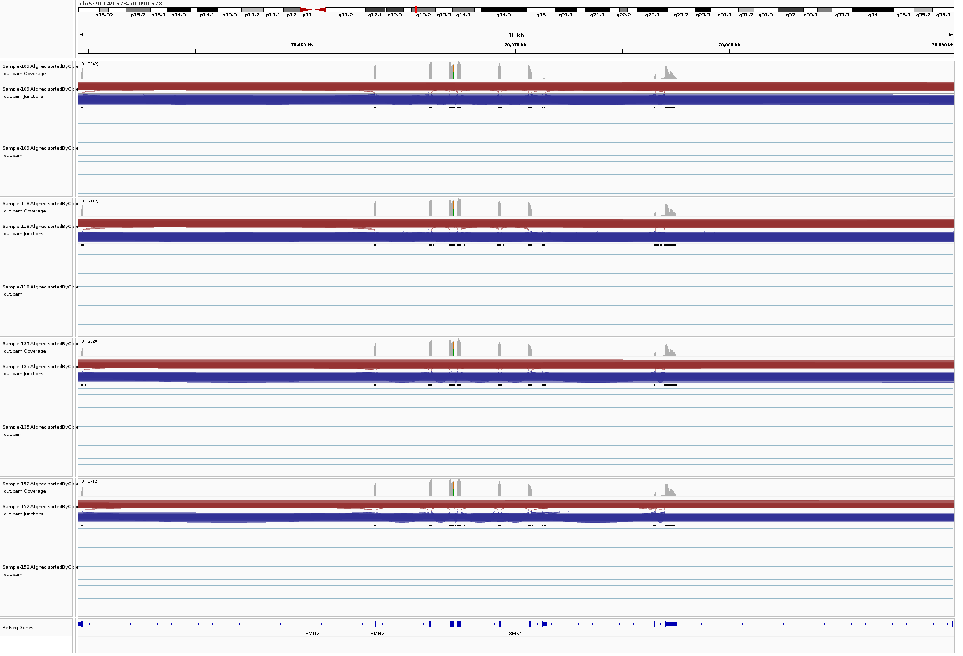
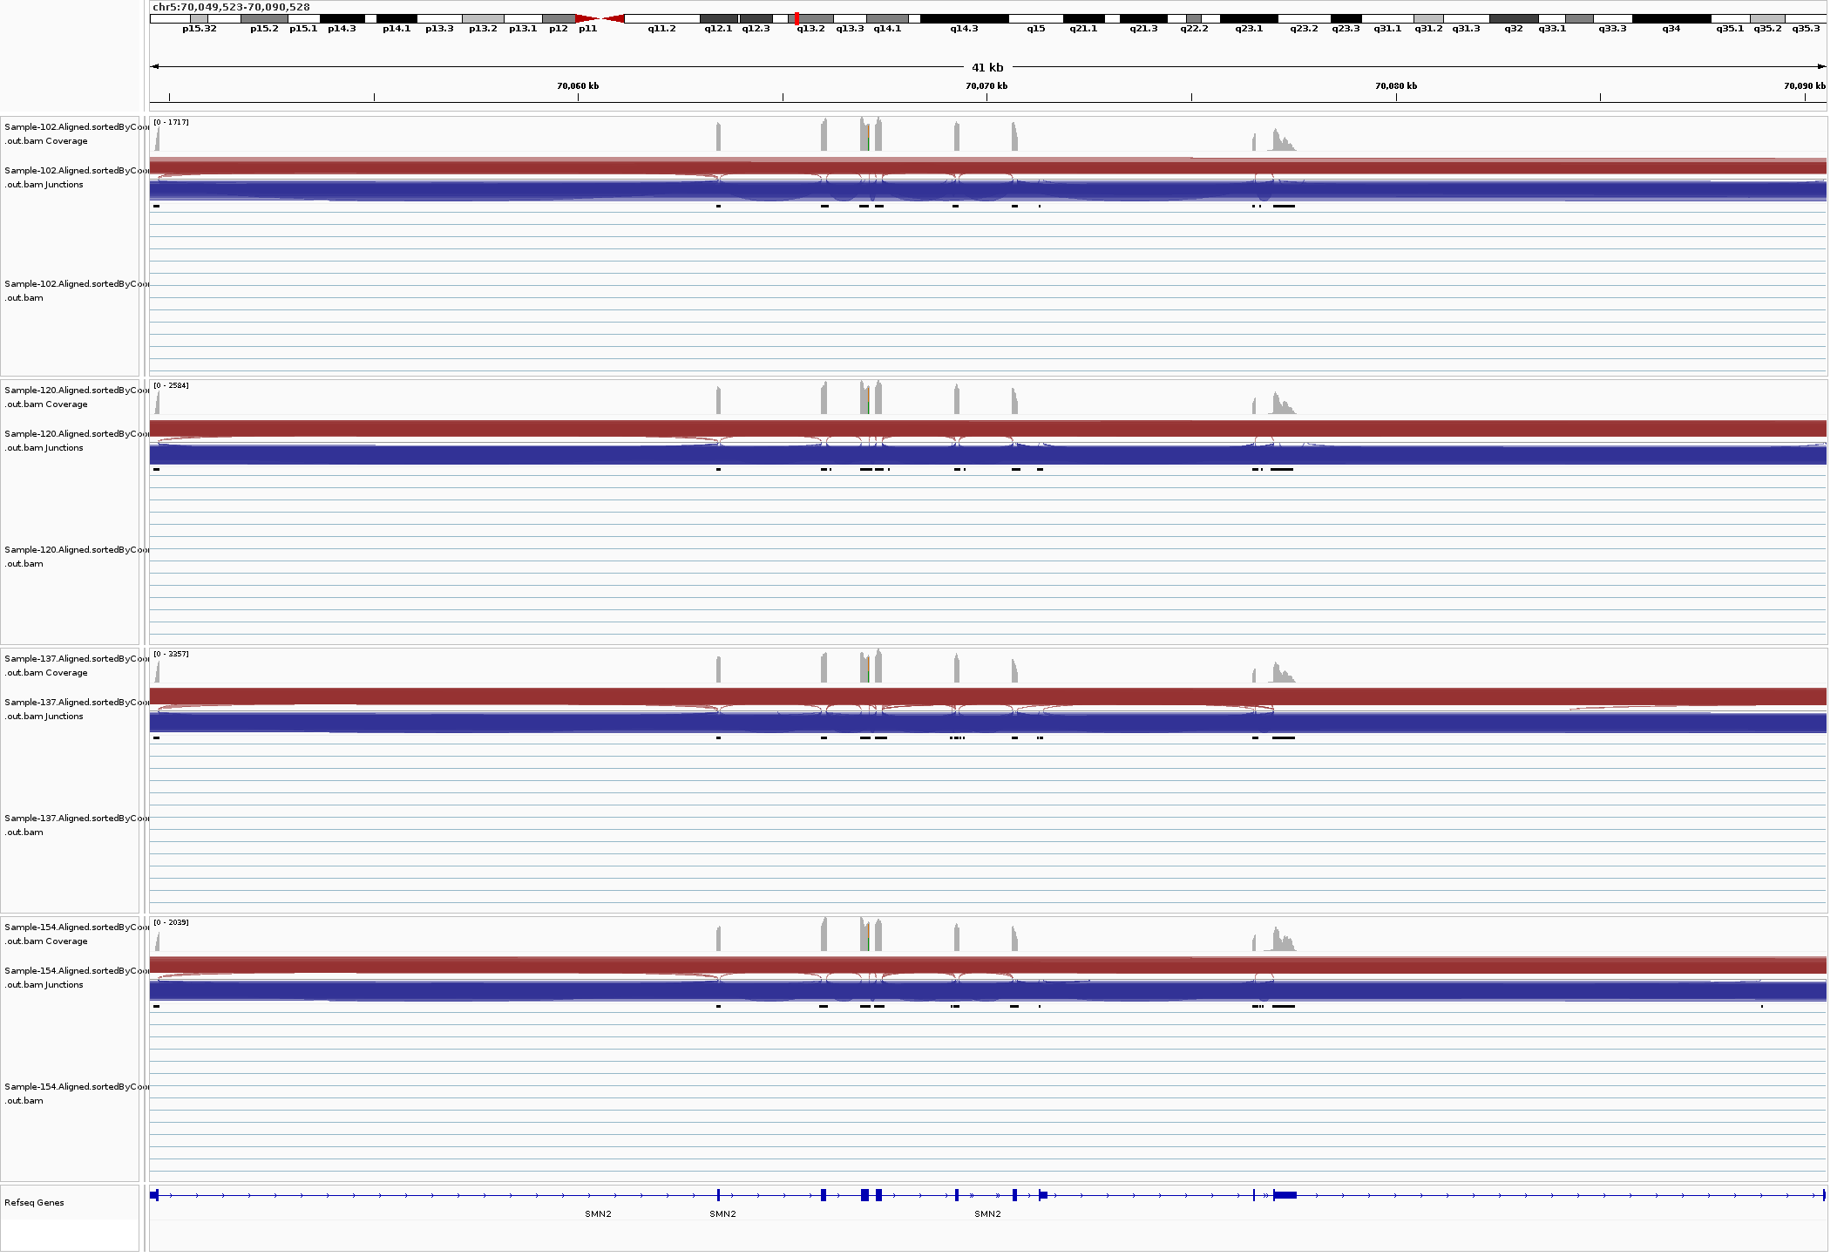
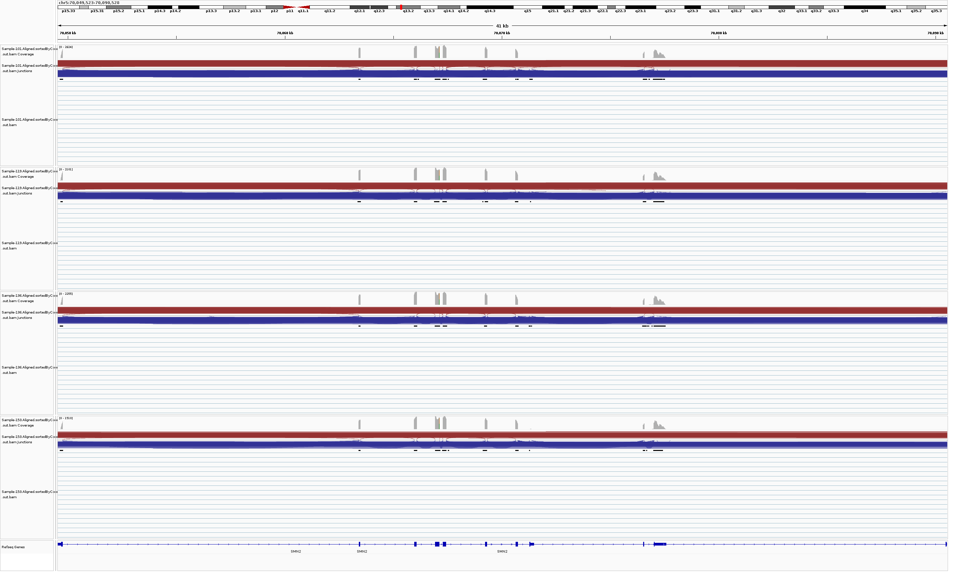
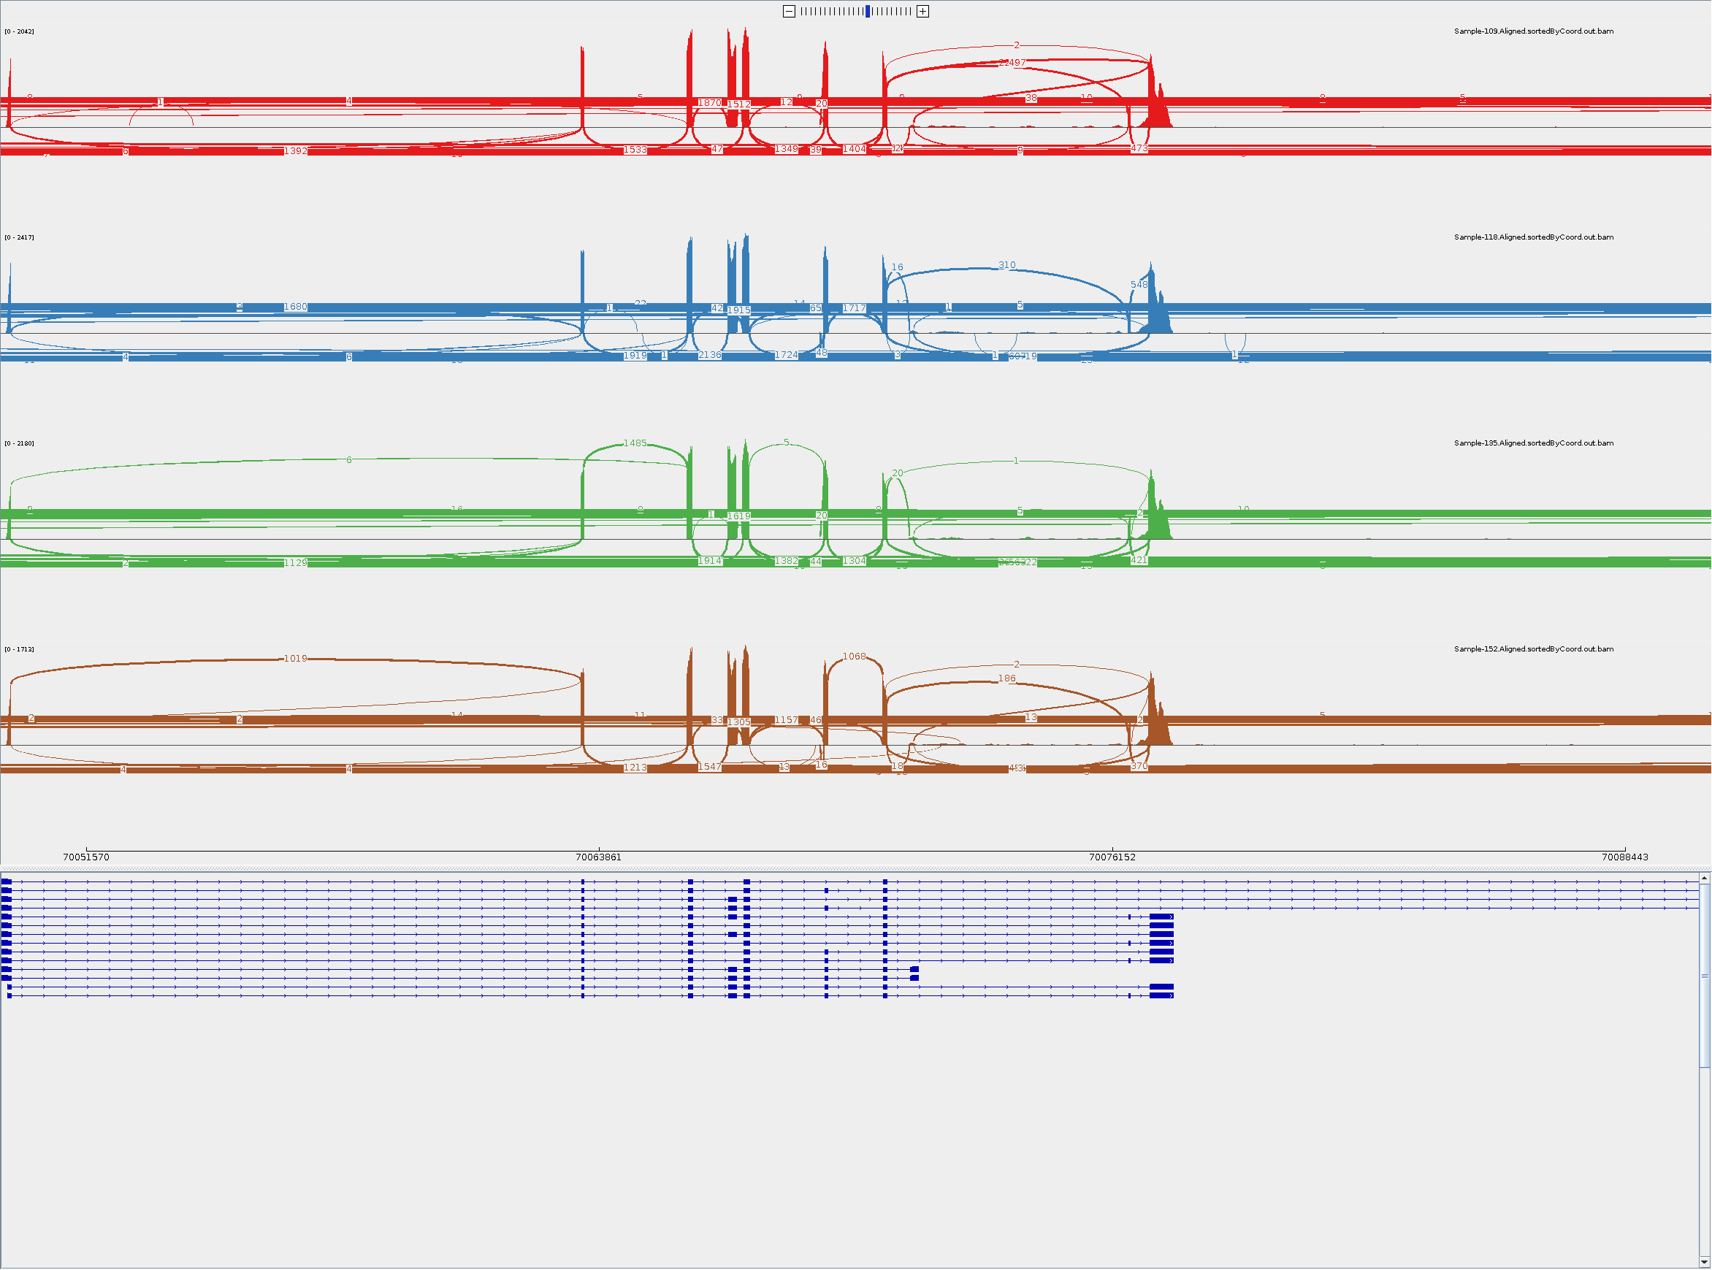
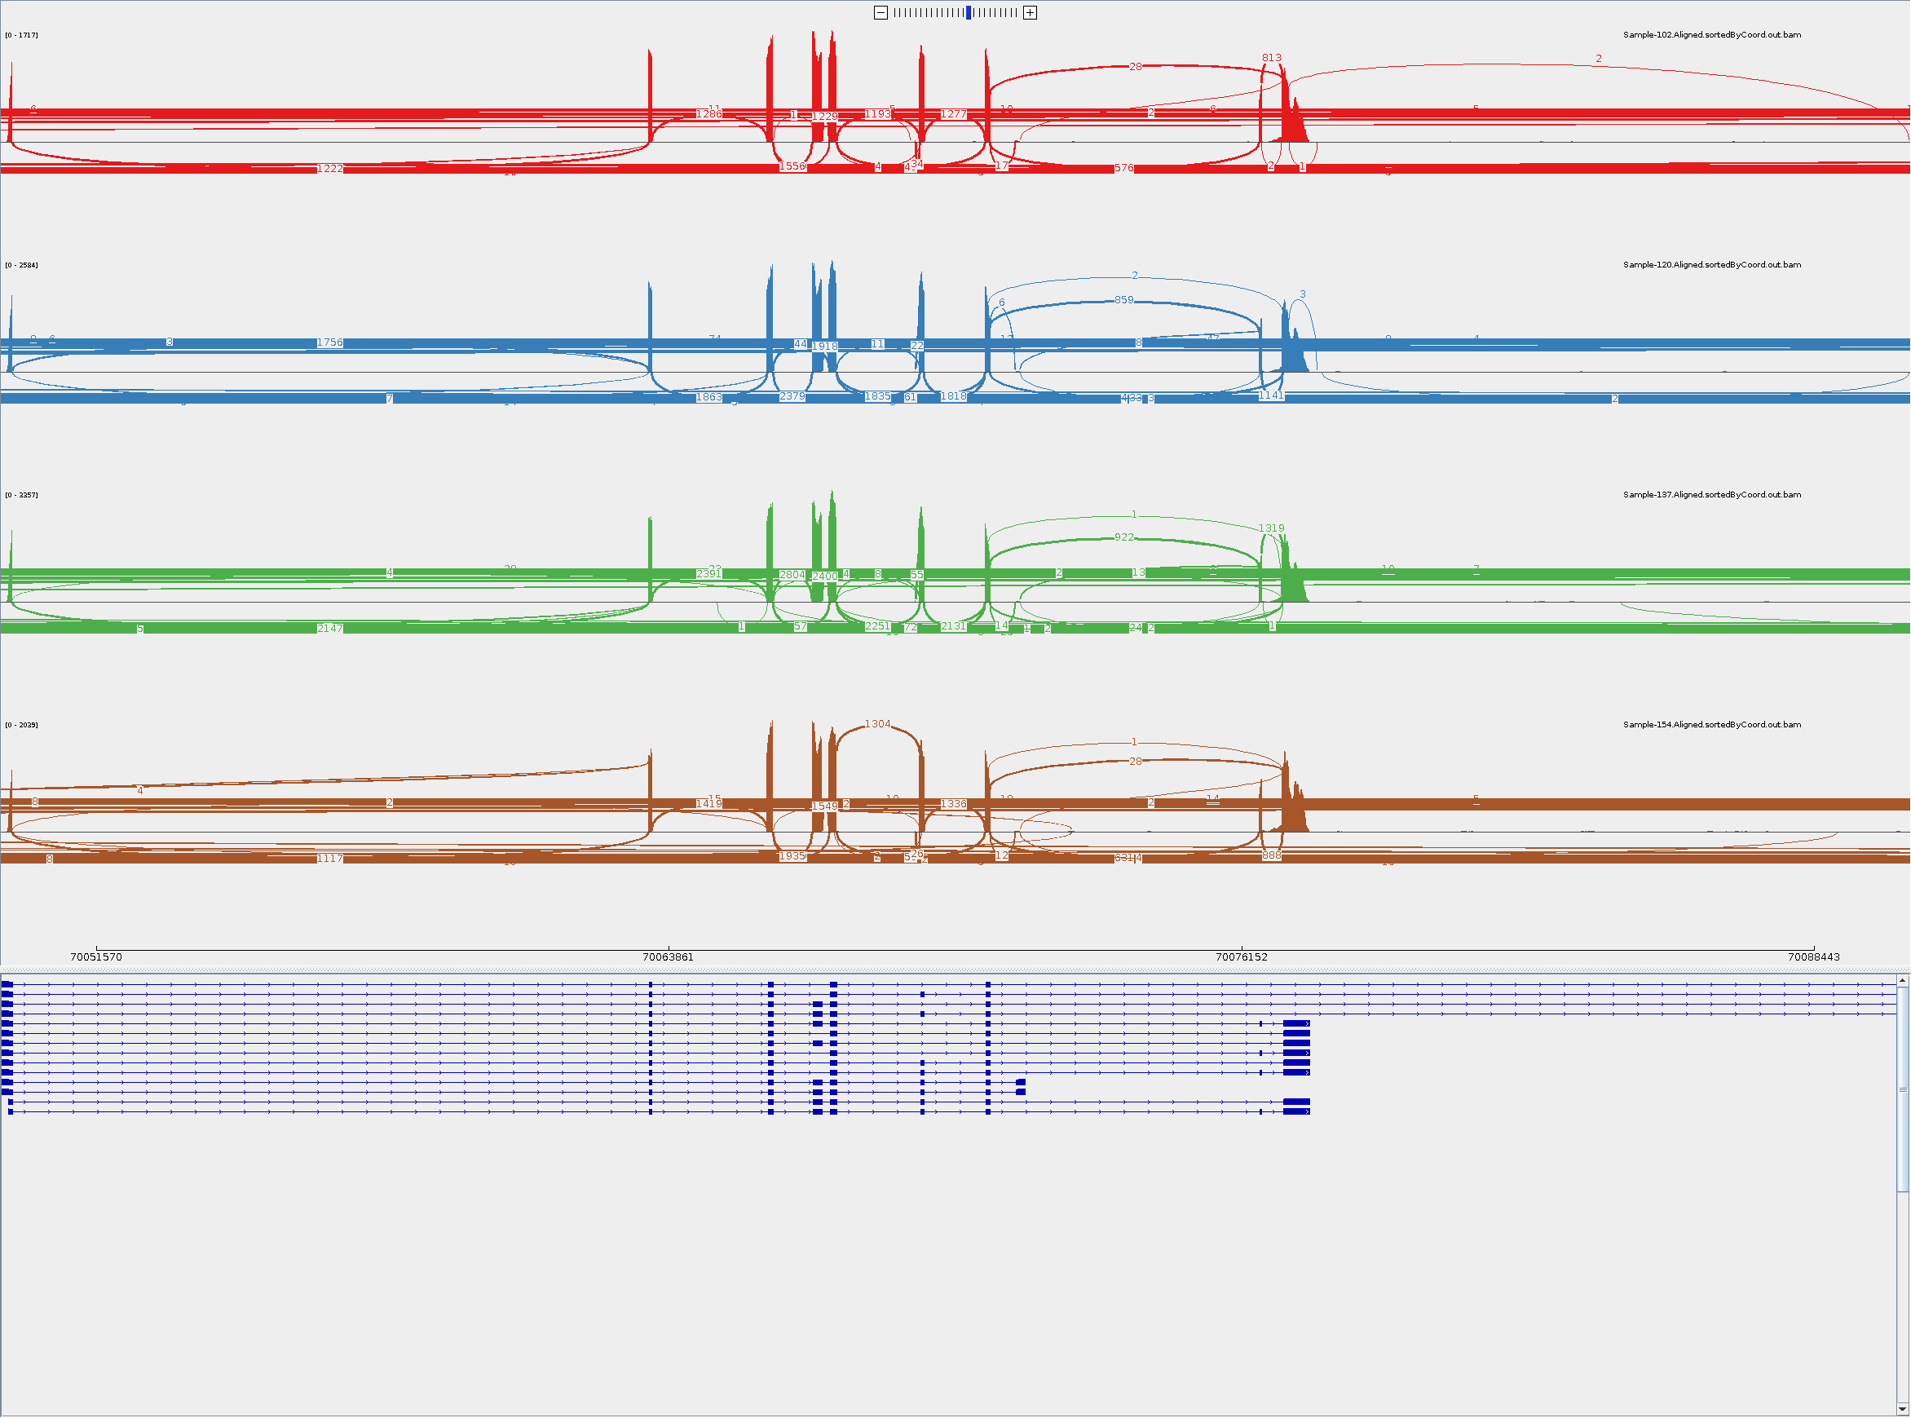
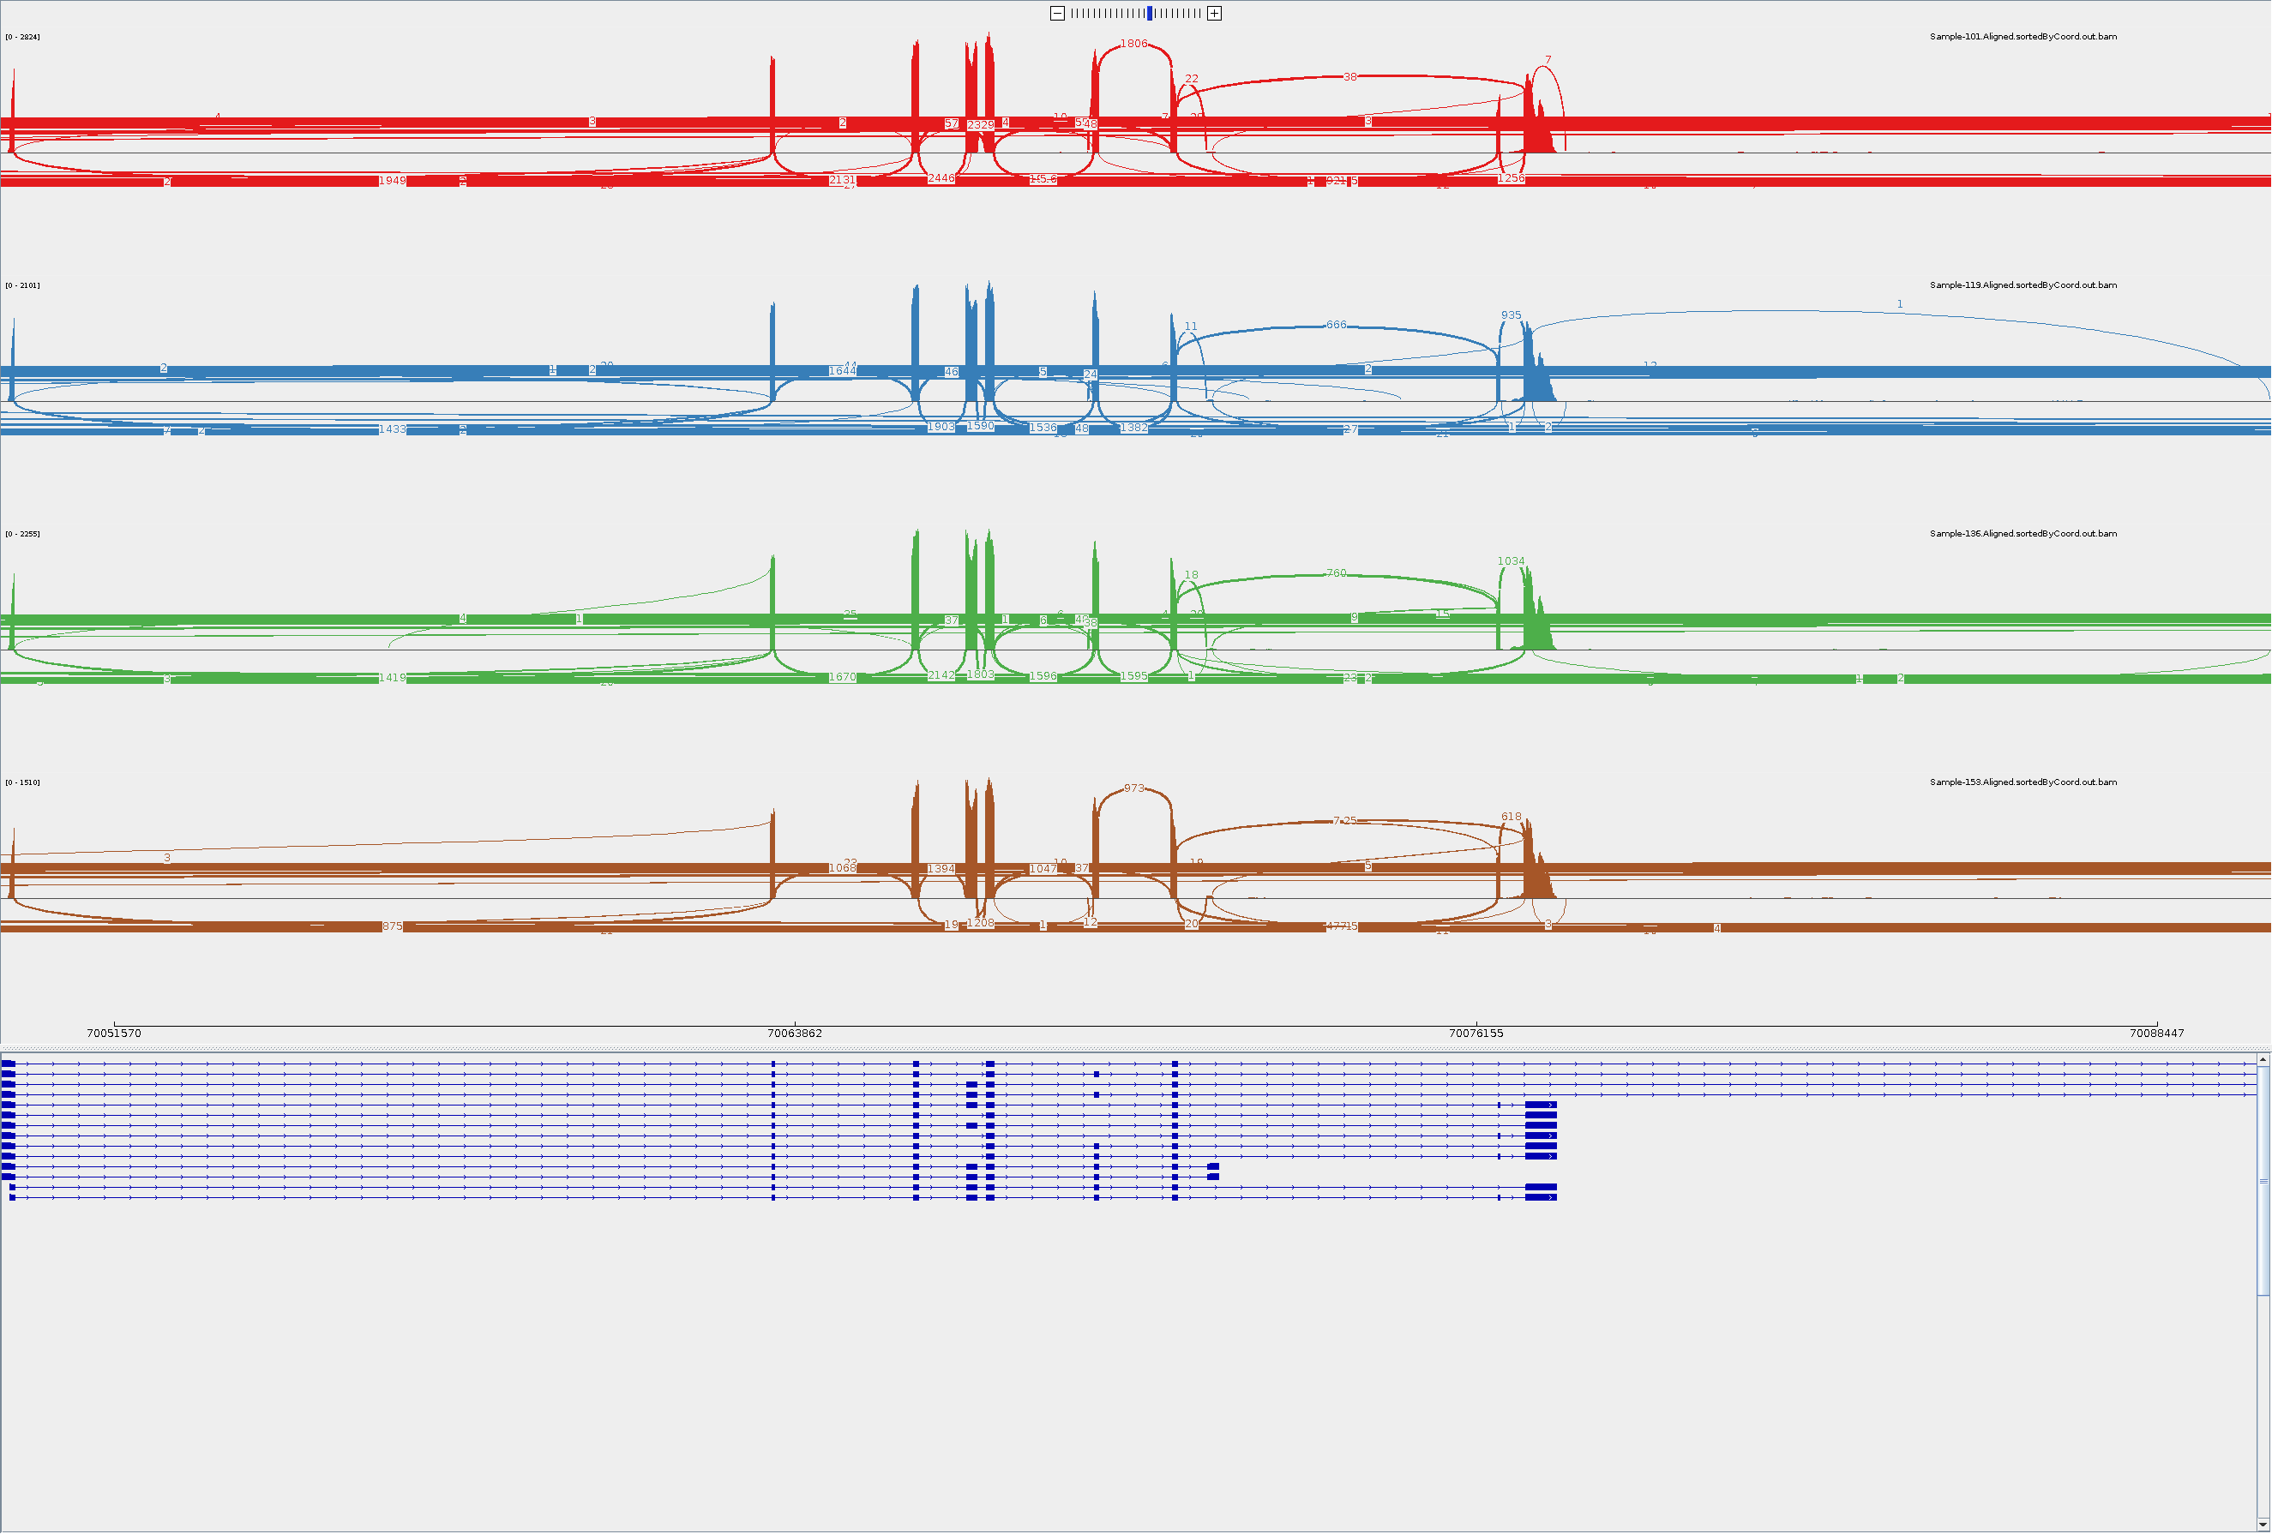
ShSy5y SMN2
DMSO
Risdiplam
6772

Slide 3
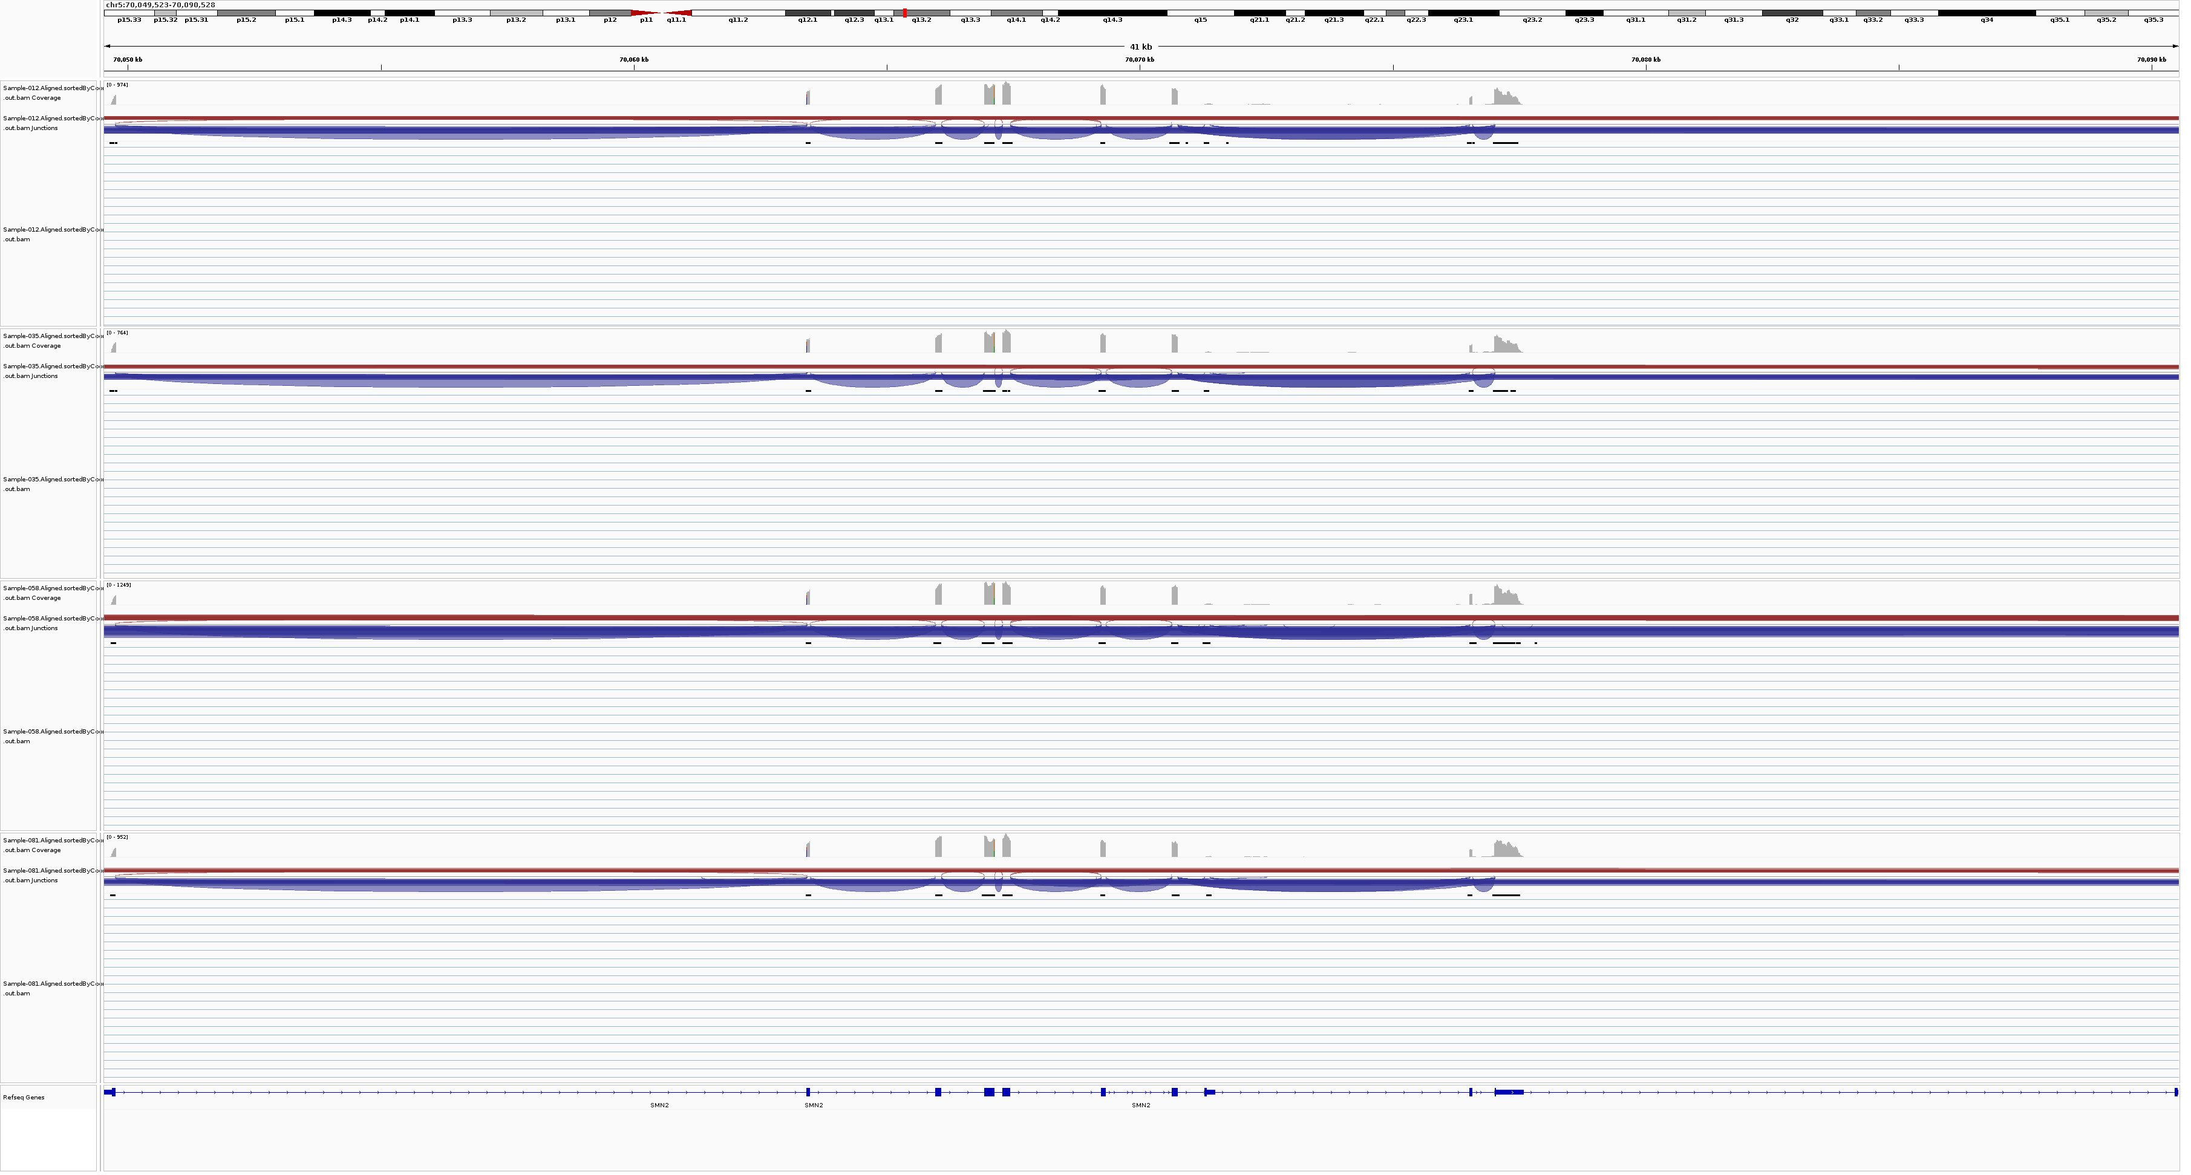
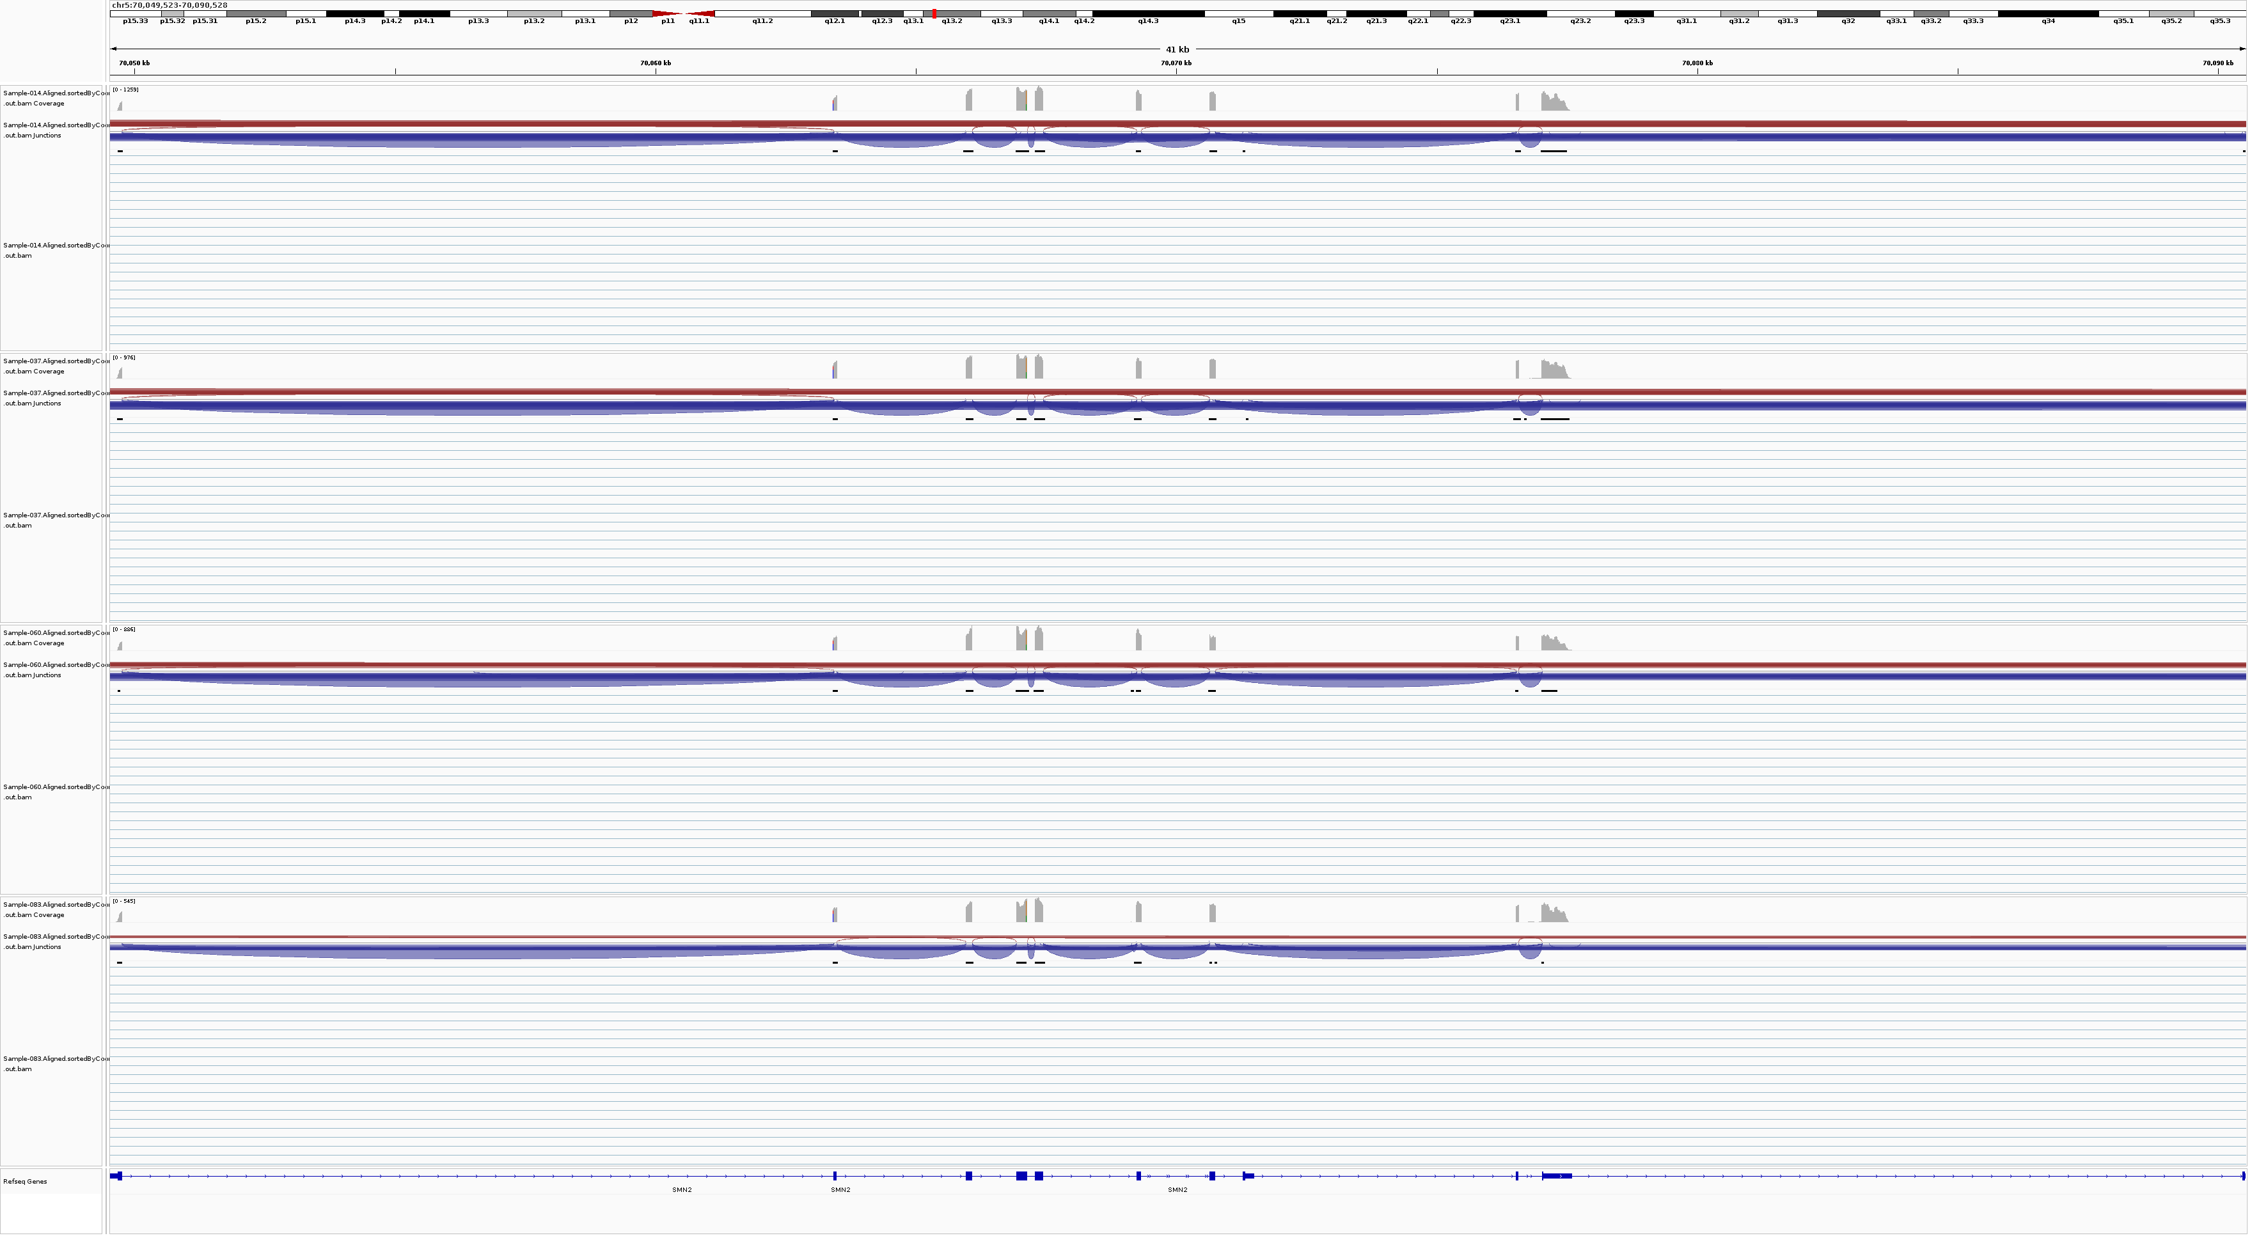
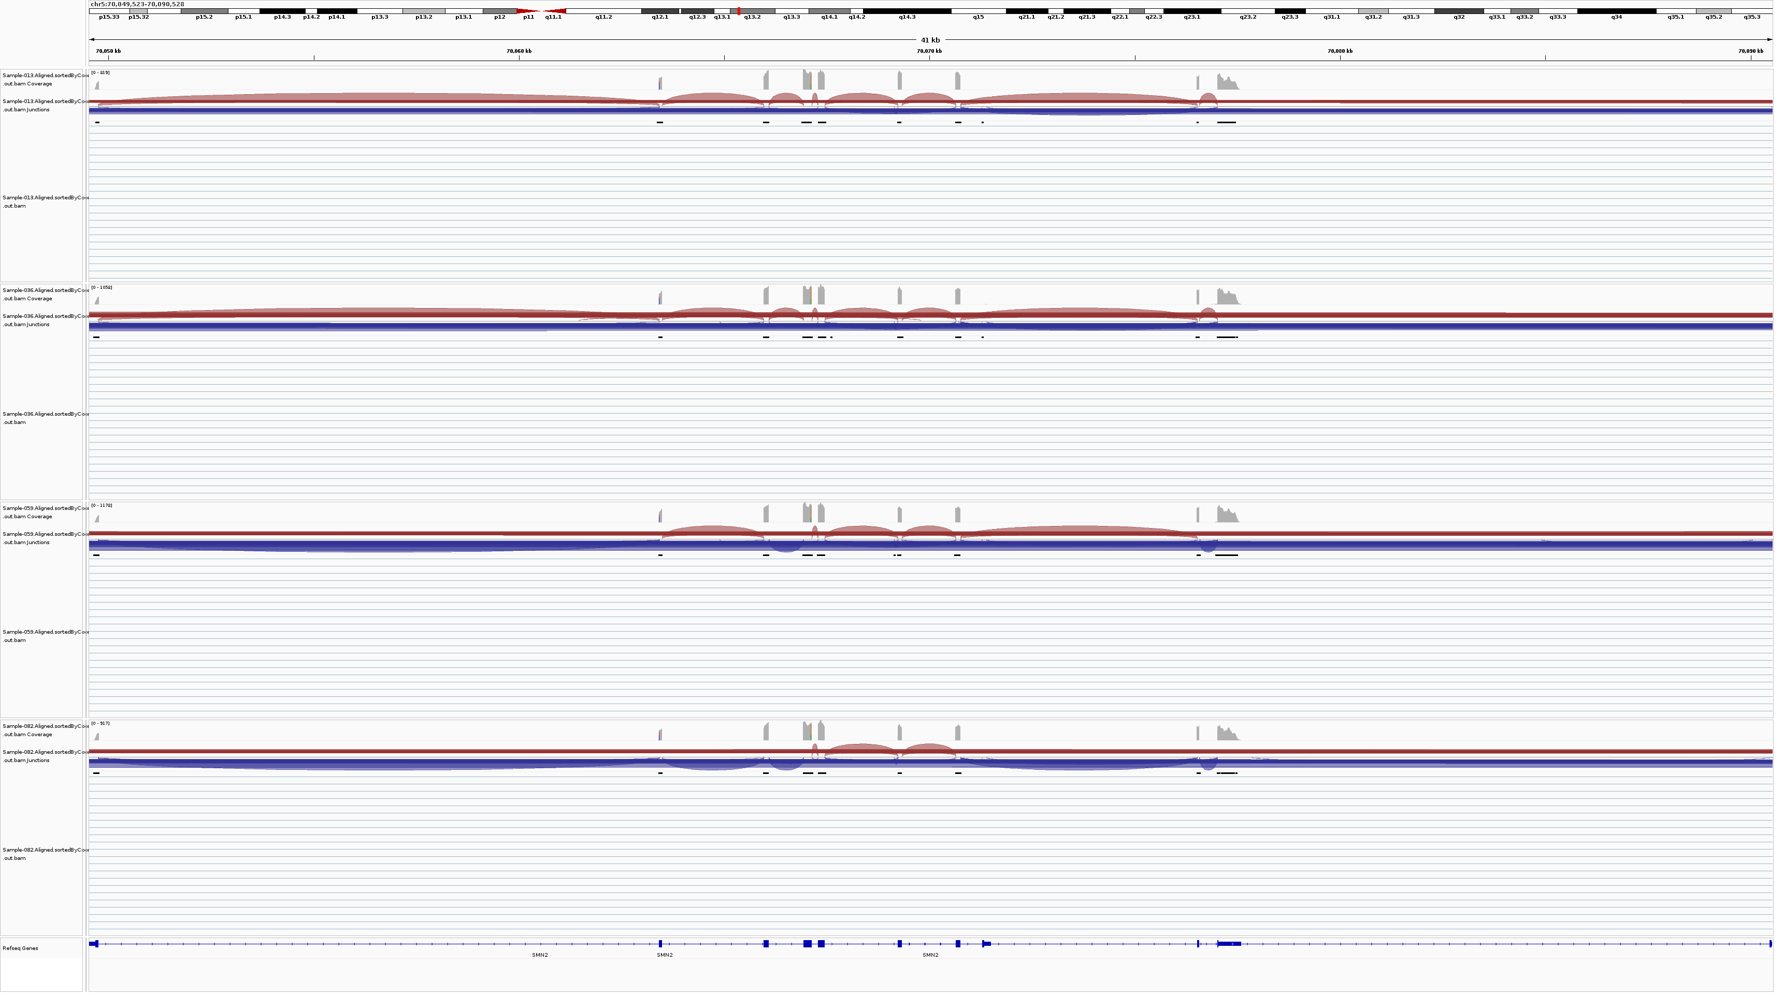
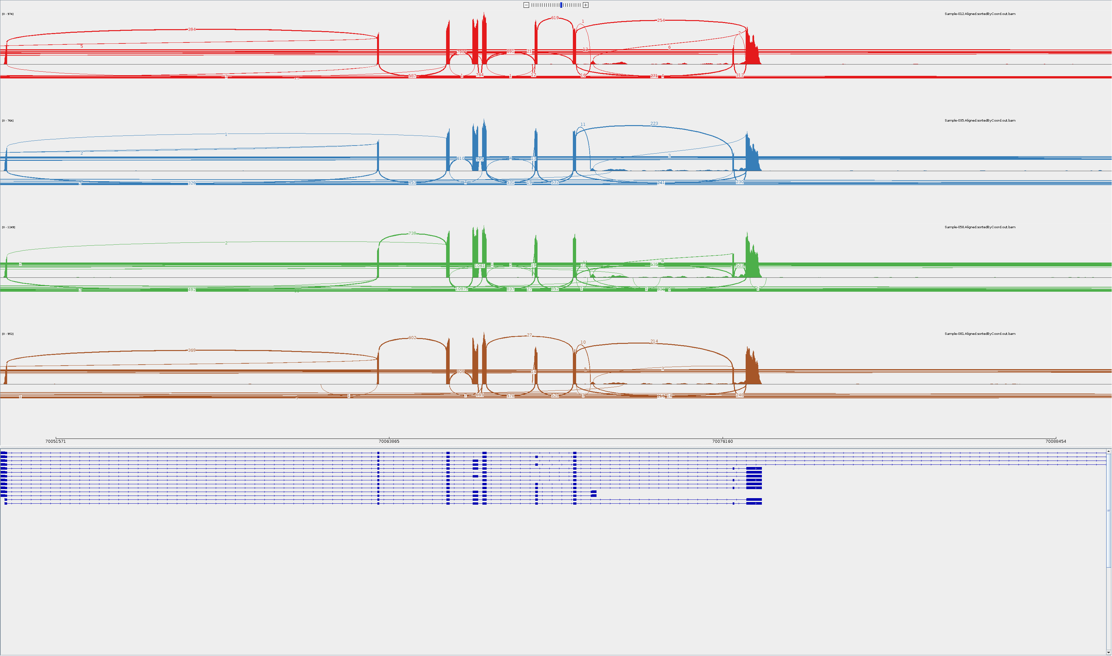
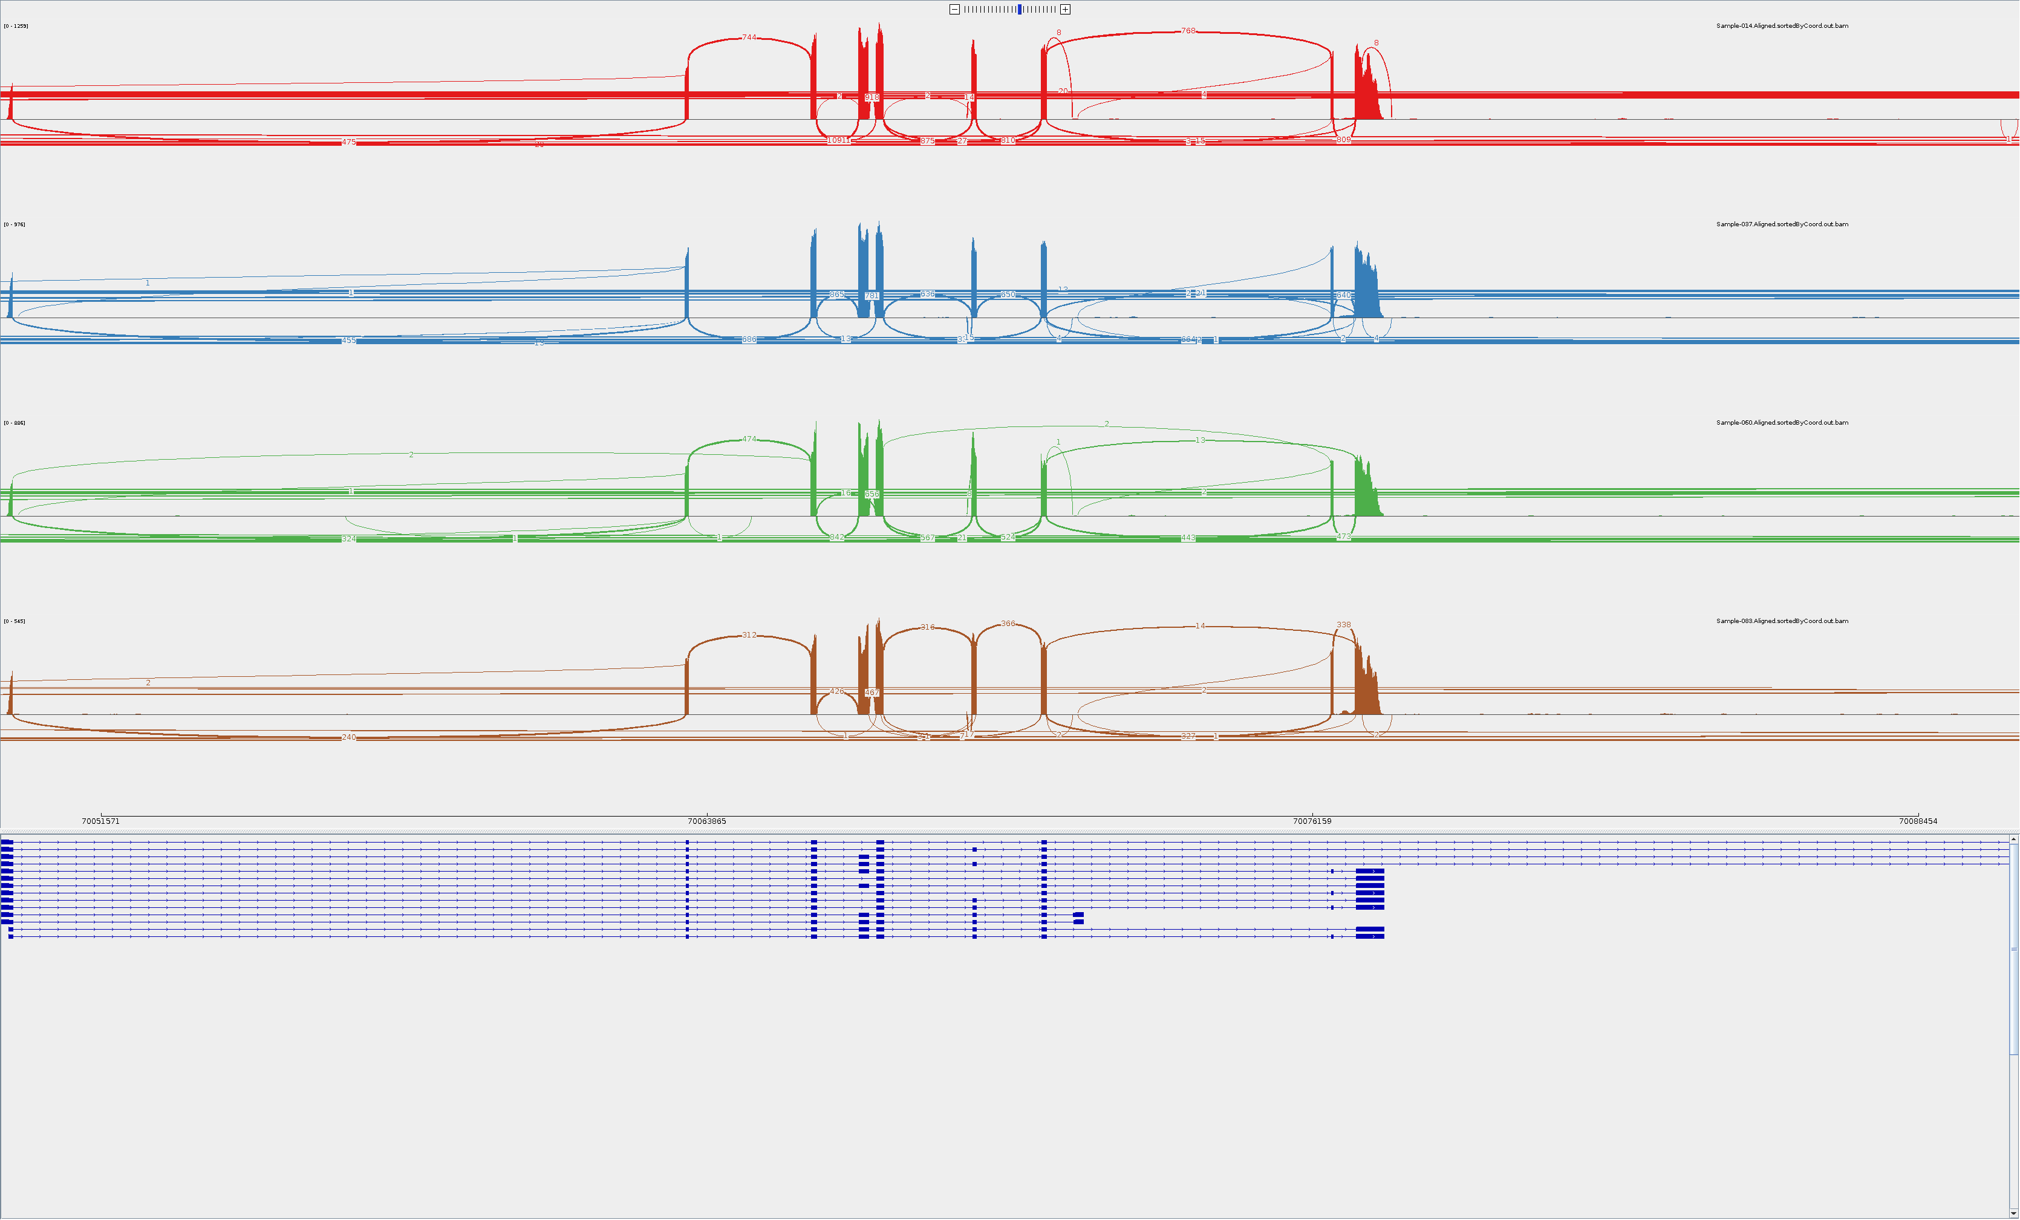
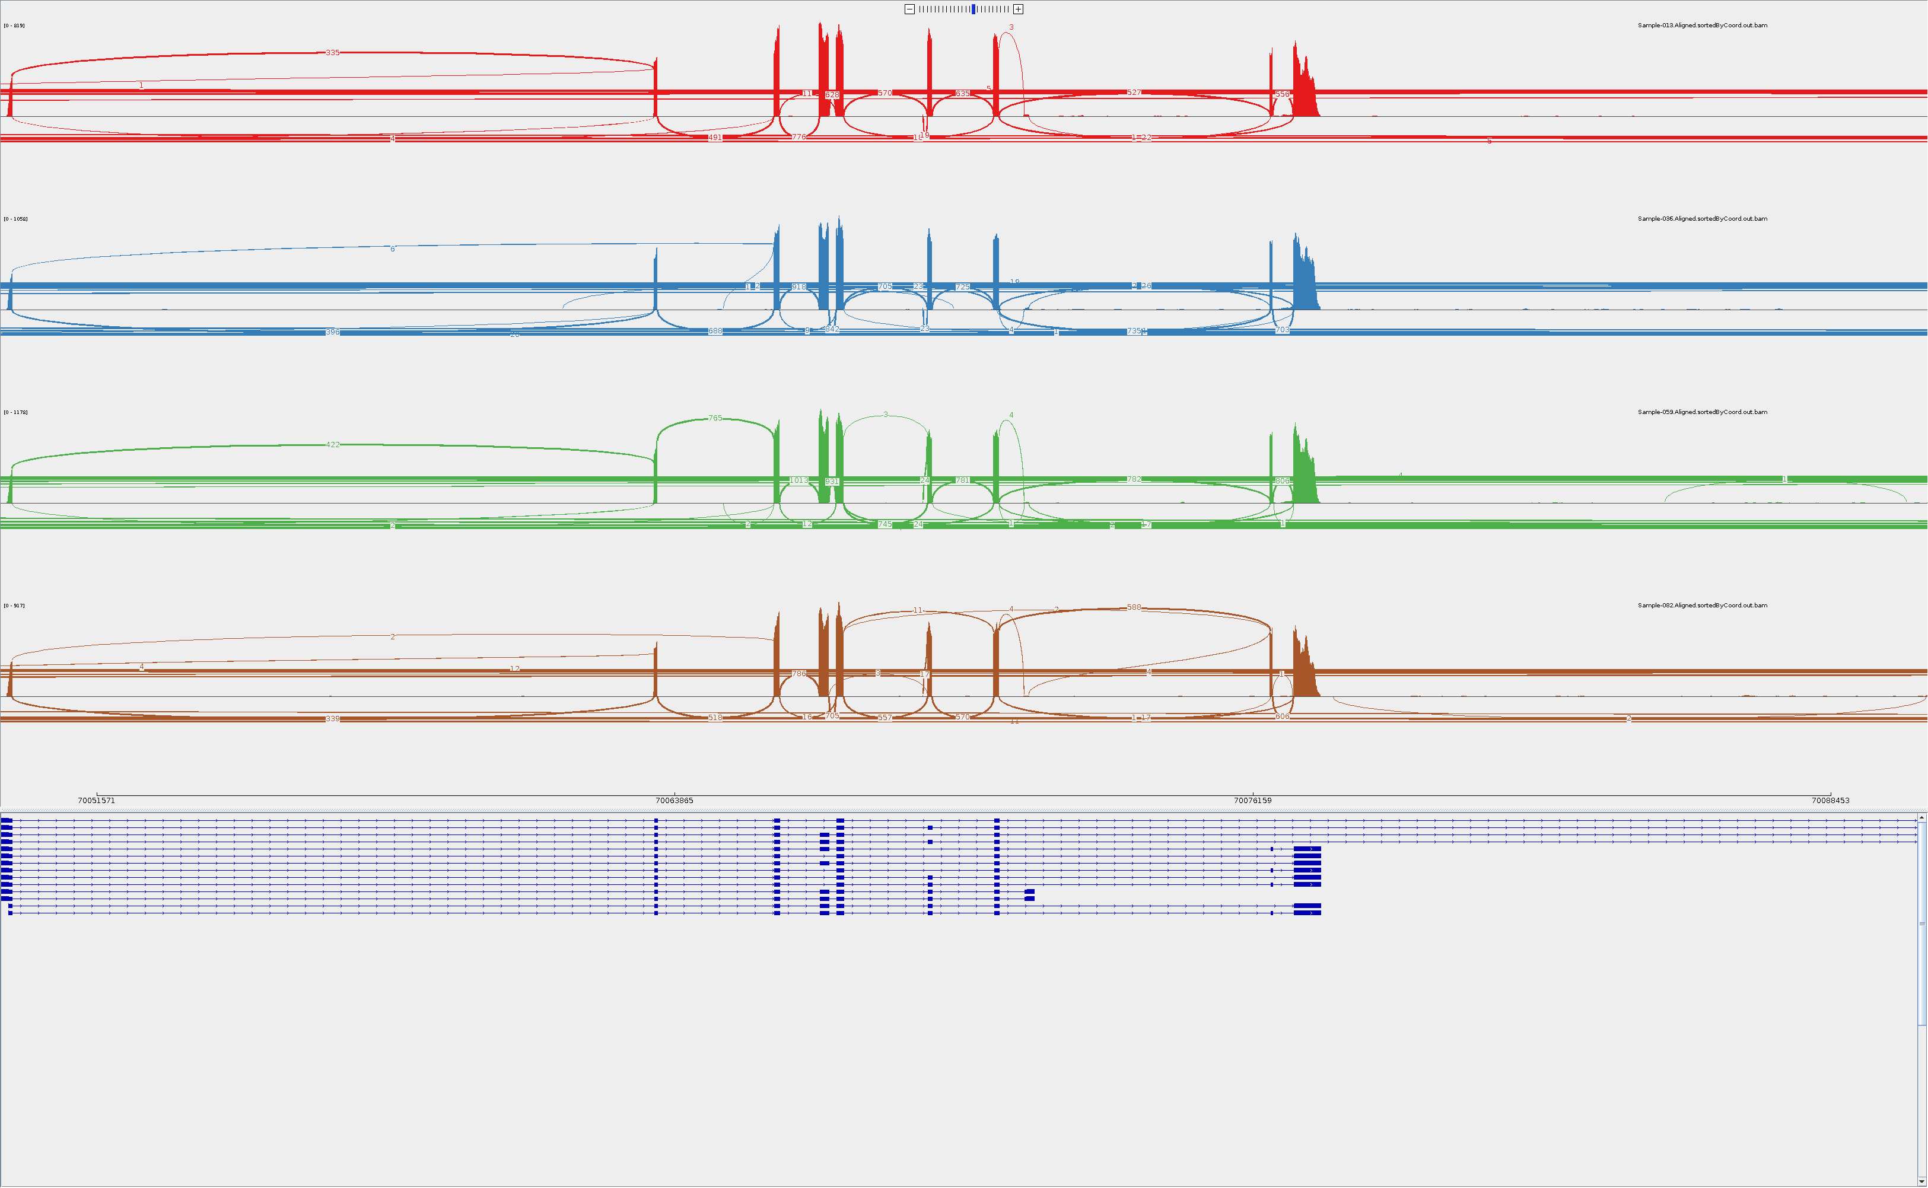
GM09677c SMA fibroblasts SMN2
DMSO
Risdiplam
6772

Slide 4
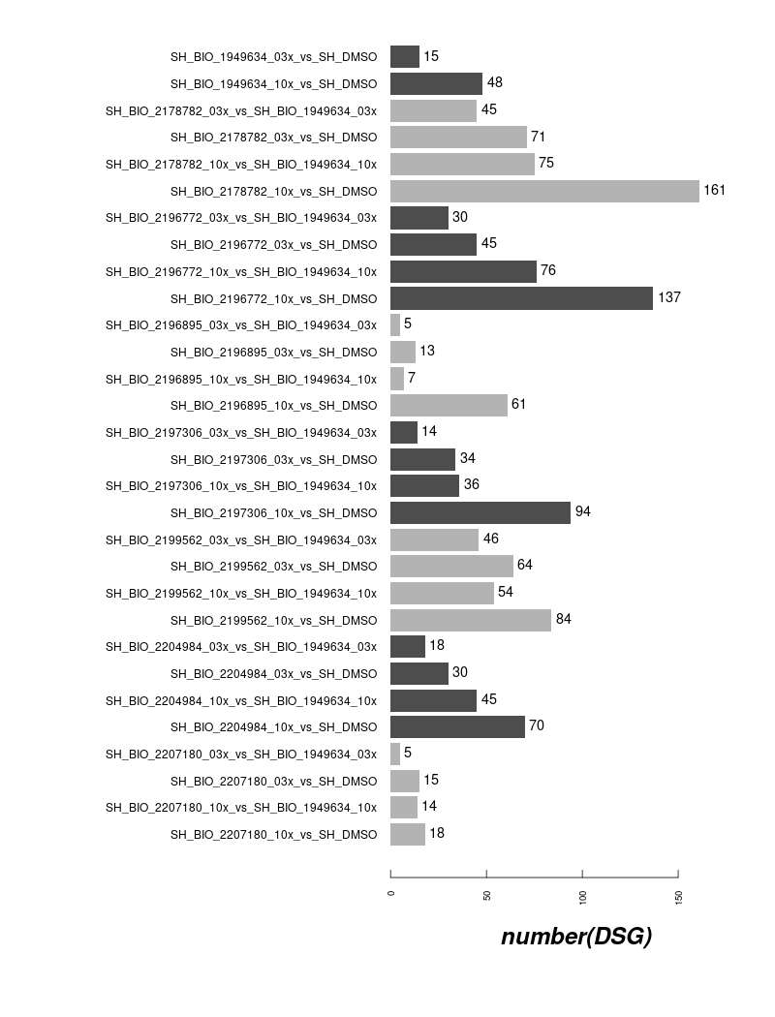
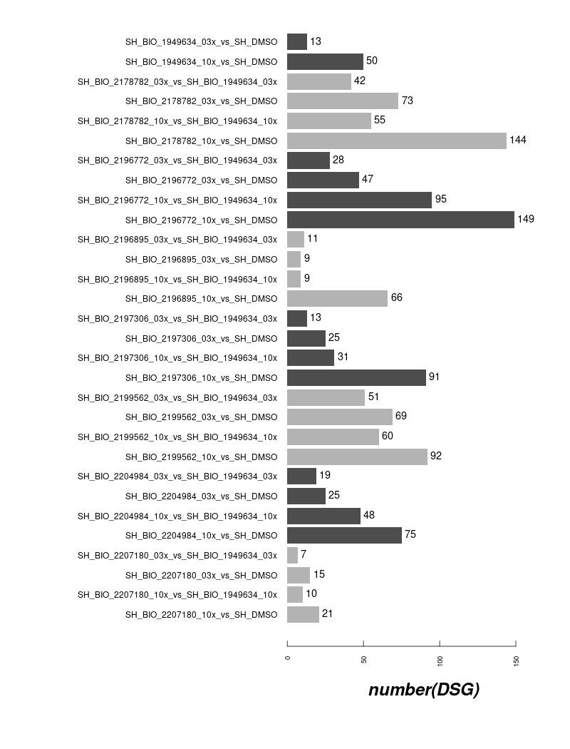
DSG Counts in ShSy5Y off-Targets (7 compounds and risdiplam)
4vs4
3vs3

Slide 5
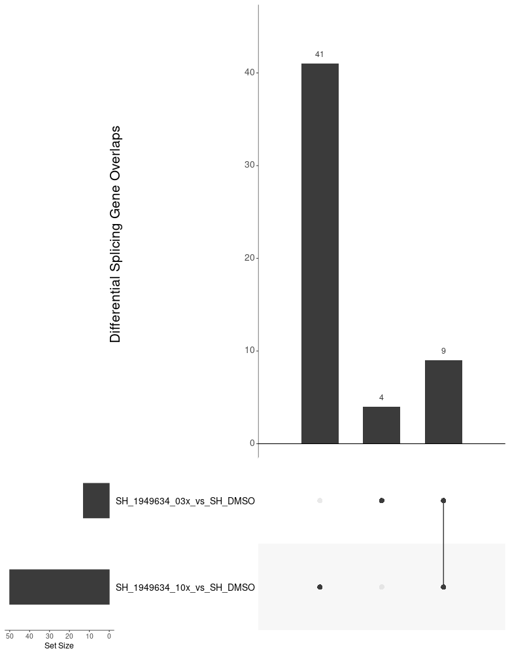
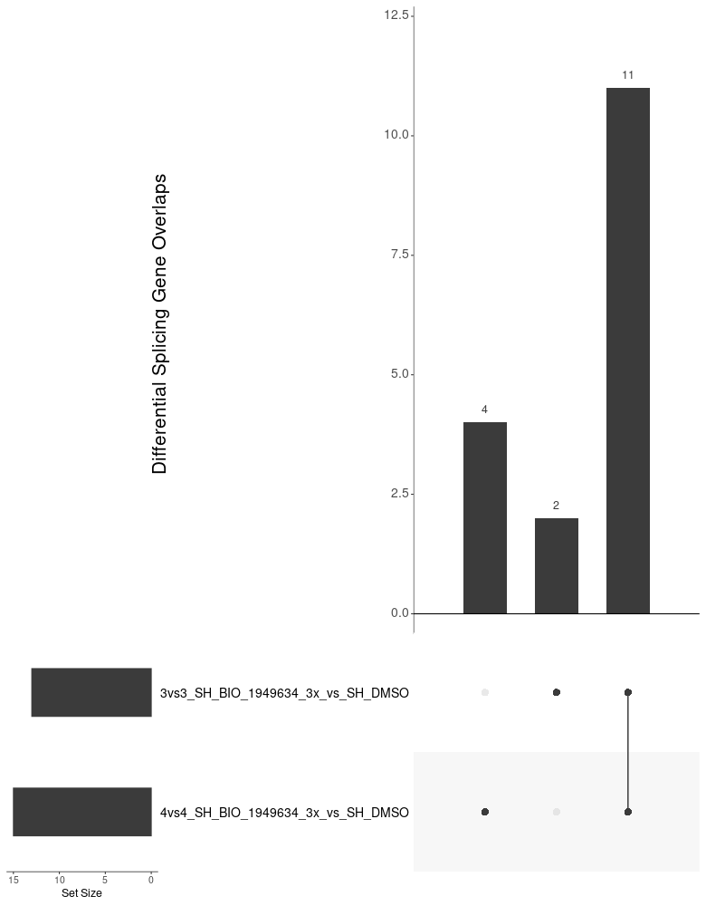
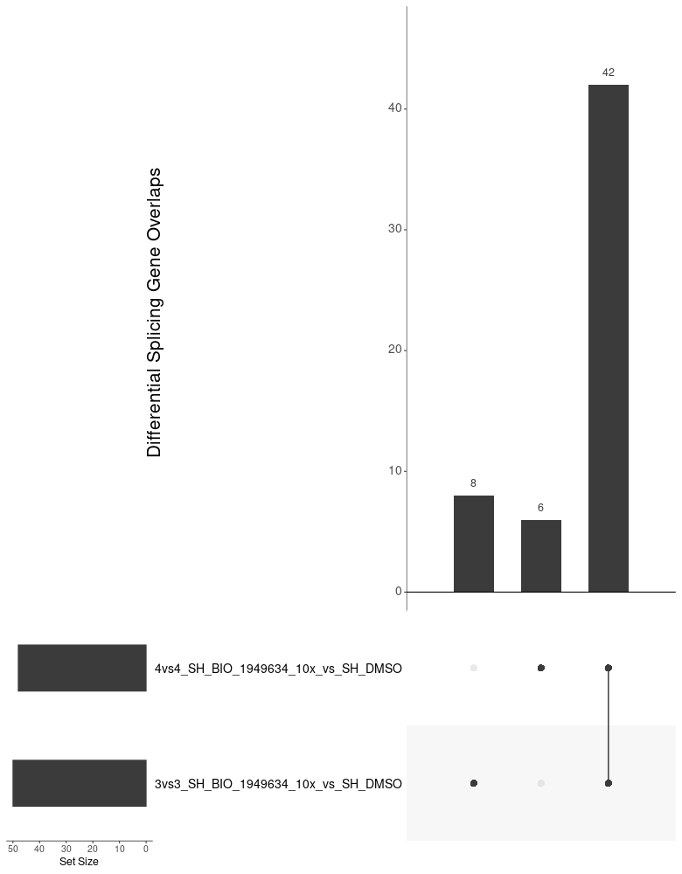
Overview of Compounds in ShSy5Y off-Targets overlap in risdiplam (within 3vs3 setting and cross 3vs3/4vs4 setting)
9/13 DSG induced by 3x Risdiplam were
Covered by 10x Risdiplam in 3vs3 setting
Most DSG induced by 3x Risdiplam
Are consistent across 3vs3 and 4vs4 setting
Super majority of the DSG induced by 10x Risdiplam
Are consistent across 3vs3 and 4vs4 setting

Slide 6
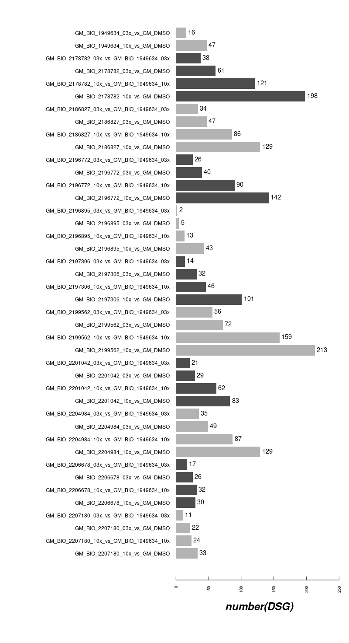

DSG Counts in GM09677c SMA fibroblasts off-Targets (10 compounds and risdiplam)
4vs4
3vs3

Slide 7
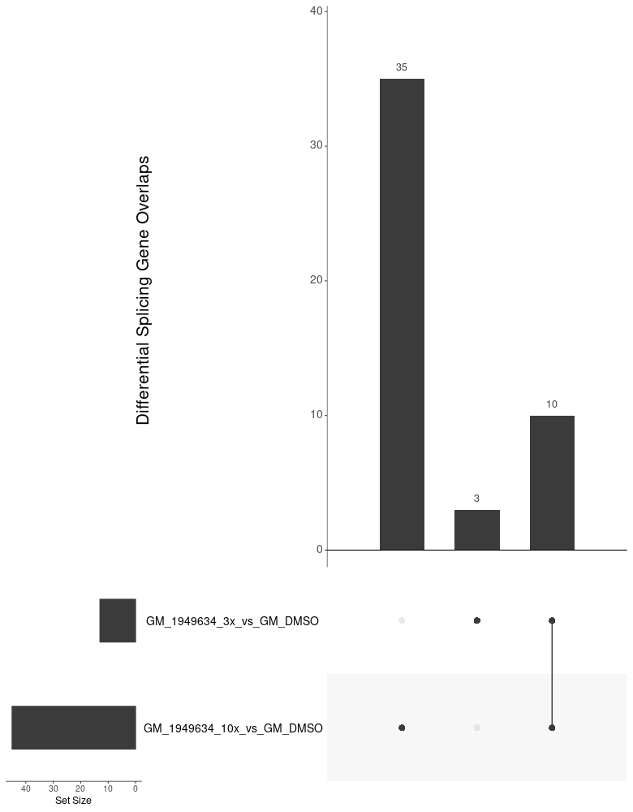
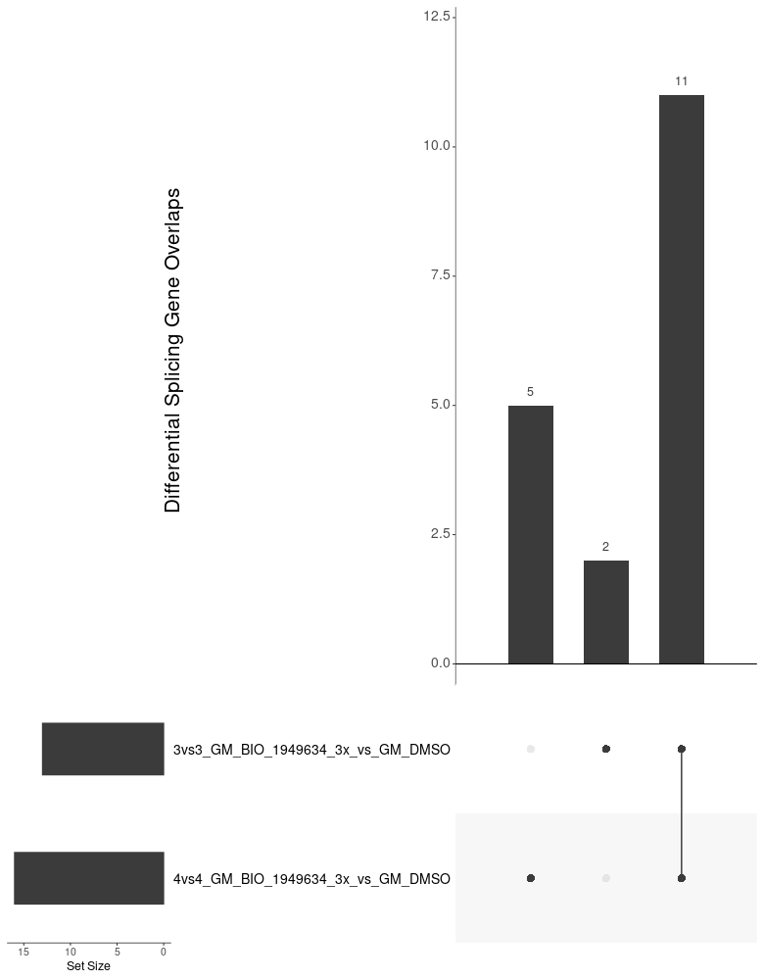

Overview of Compounds in GM09677c off-Targets overlap in risdiplam (within 3vs3 setting and cross 3vs3/4vs4 setting)
10/13 DSG induced by 3x Risdiplam were
Covered by 10x Risdiplam in 3vs3 setting
Most DSG induced by 3x Risdiplam
Are consistent across 3vs3 and 4vs4 setting
Super majority of the DSG induced by 10x Risdiplam
Are consistent across 3vs3 and 4vs4 setting

Slide 8
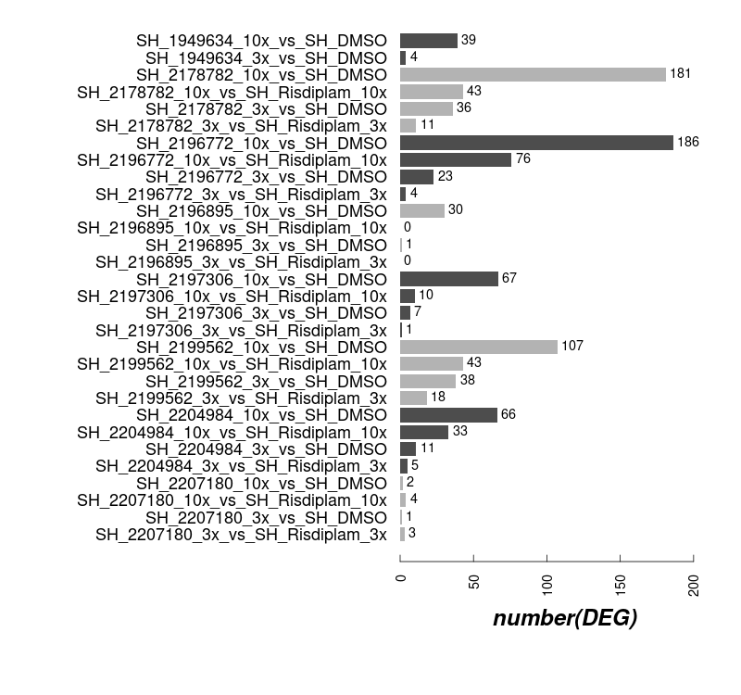
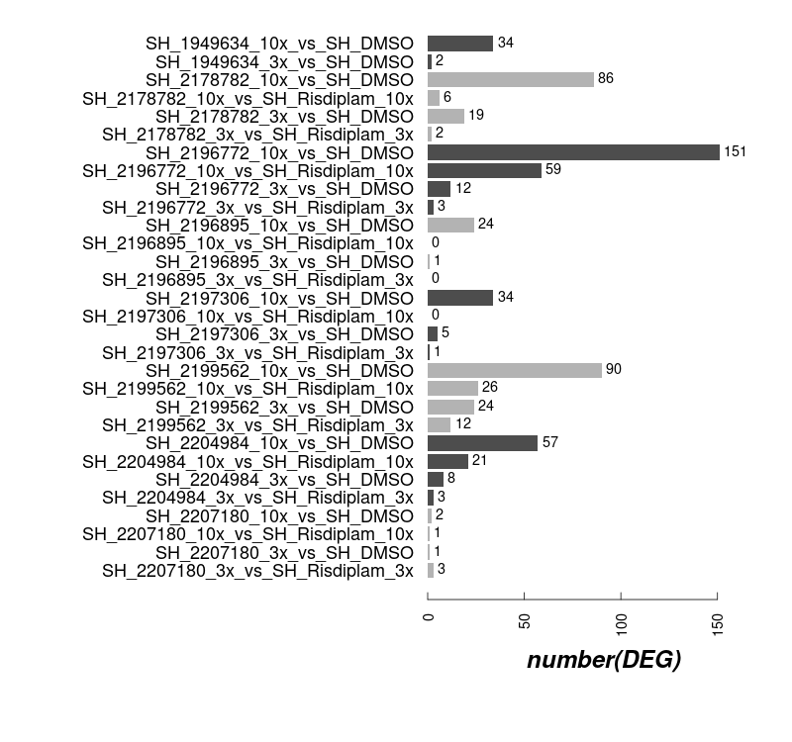
DEG Counts in ShSy5Y off-Targets (7 compounds and risdiplam)
4vs4
3vs3

Slide 9
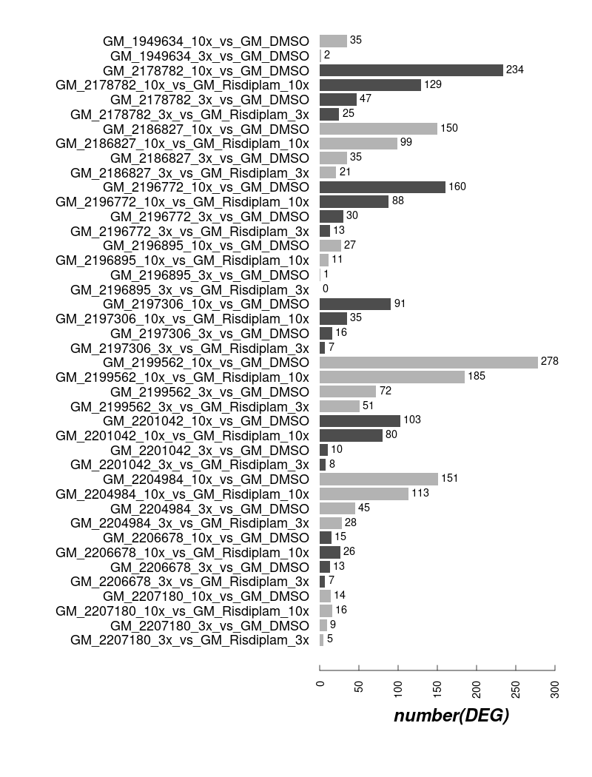

DEG Counts in GM09677c SMA fibroblasts off-Targets (10 compounds and risdiplam)
4vs4
3vs3

Slide 10
http://compbio.biogen.com:3838/Quickomics/?testfile=TST12188_ShSy5Y
http://compbio.biogen.com:3838/Quickomics/?testfile=TST12188_GM_Ris
http://compbio.biogen.com:3838/Quickomics/?testfile=TST12188_GM09677c_3vs3
http://compbio.biogen.com:3838/Quickomics/?testfile=TST12188_Sh_GR38_3vs3

Slide 11
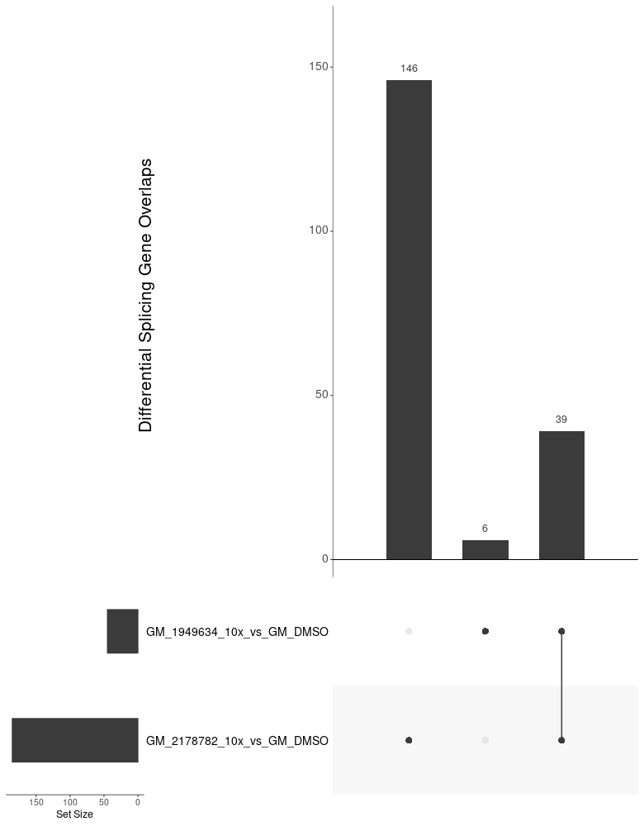
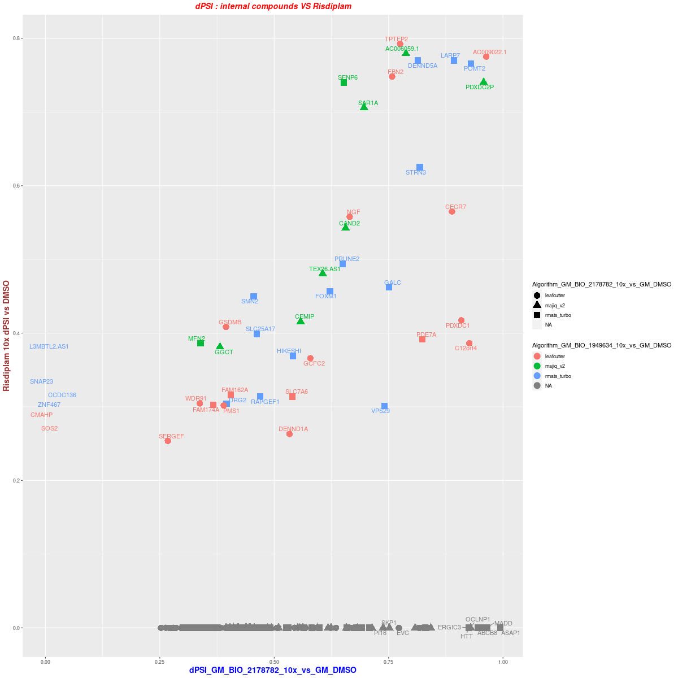
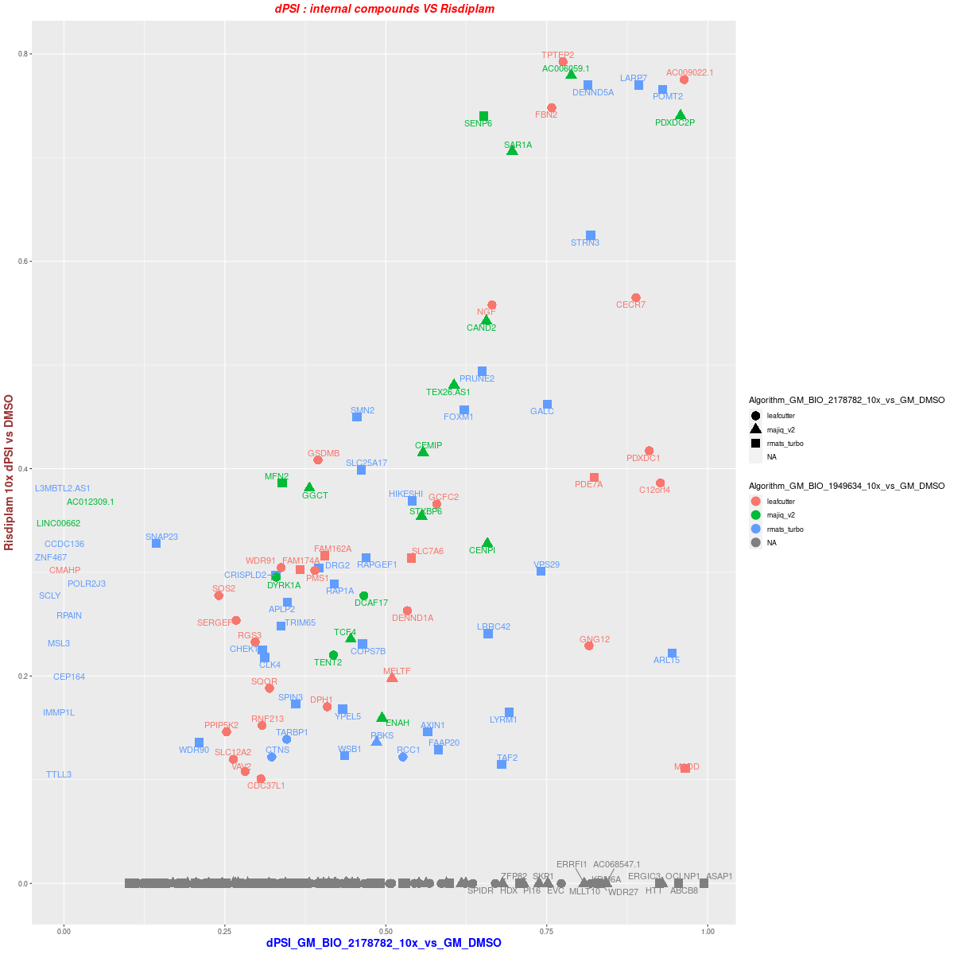
GM 3vs3--10x DSG BIO_2178782
DSG overlap (dPSI >= 0.25)
dPSI distribution ( >= 0.25 in one treatment)
dPSI distribution ( >= 0.1 in one treatment)

Slide 12
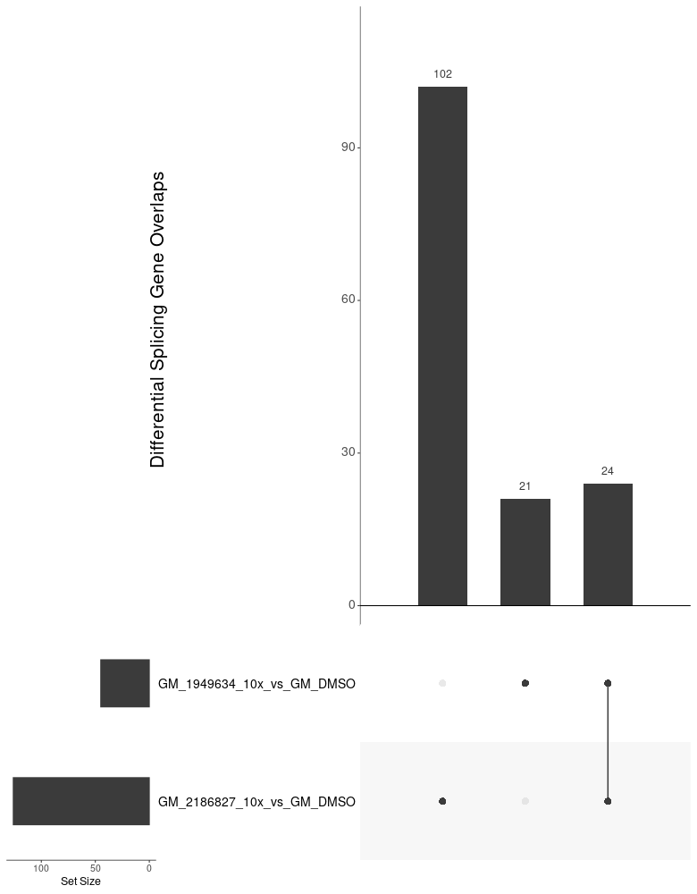
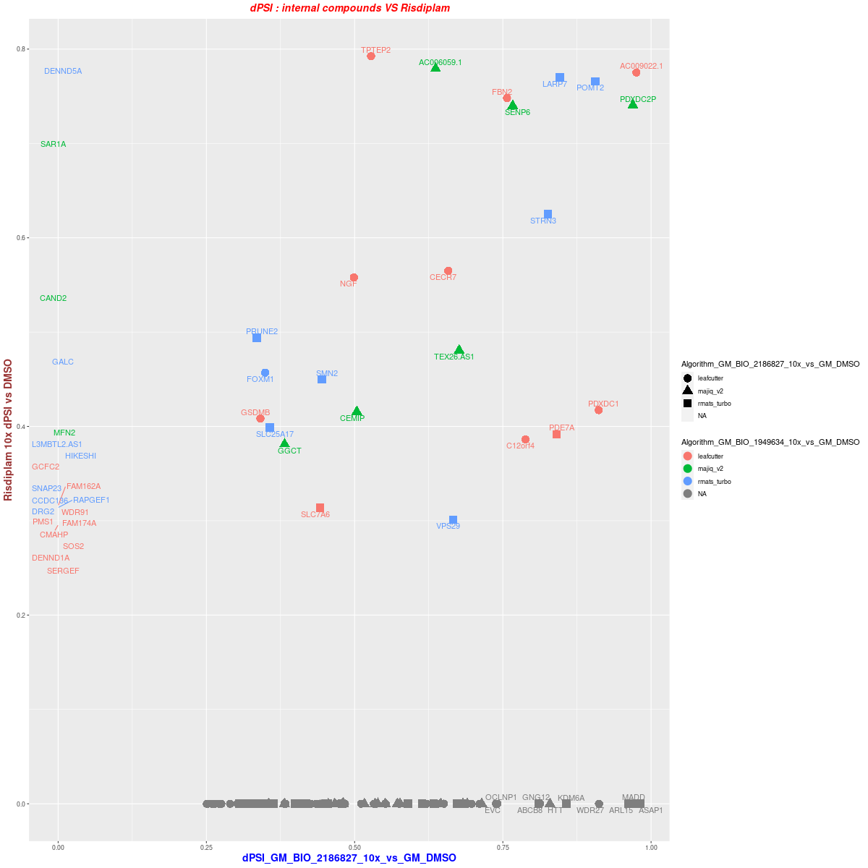
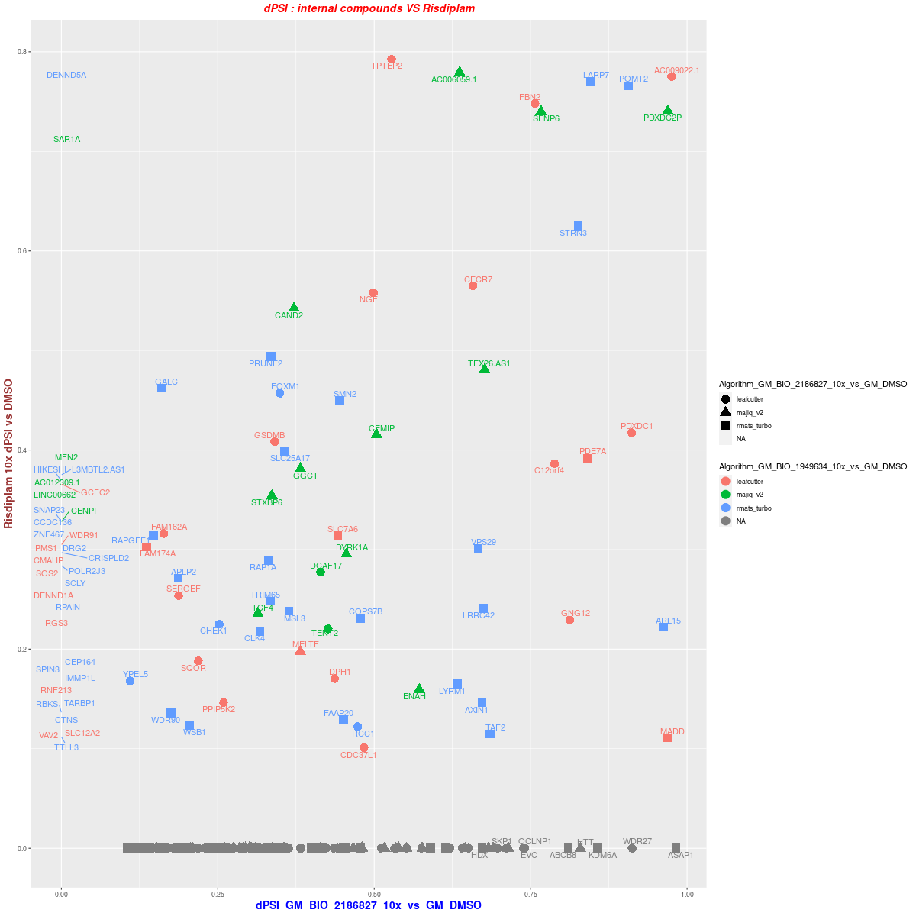
GM 3vs3 --10x DSG BIO_2186827
DSG overlap (dPSI >= 0.25)
dPSI distribution ( >= 0.25 in one treatment)
dPSI distribution ( >= 0.1 in one treatment)

Slide 13
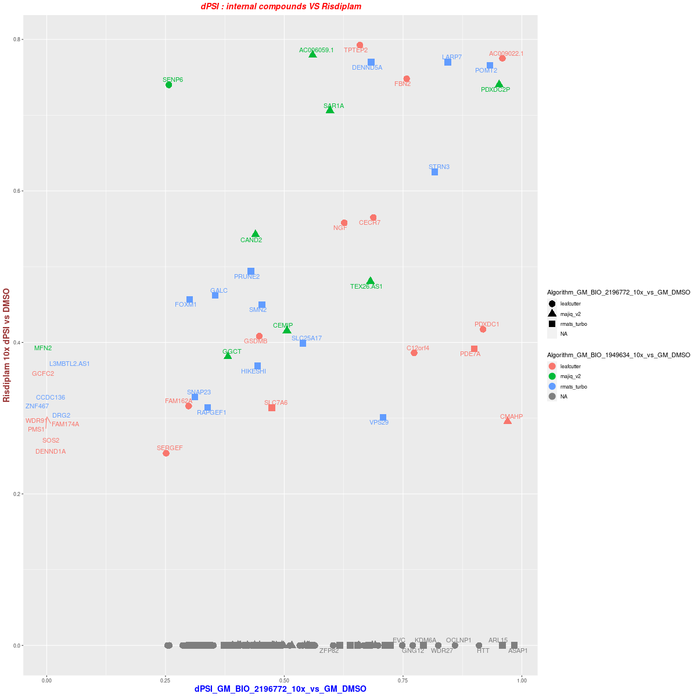
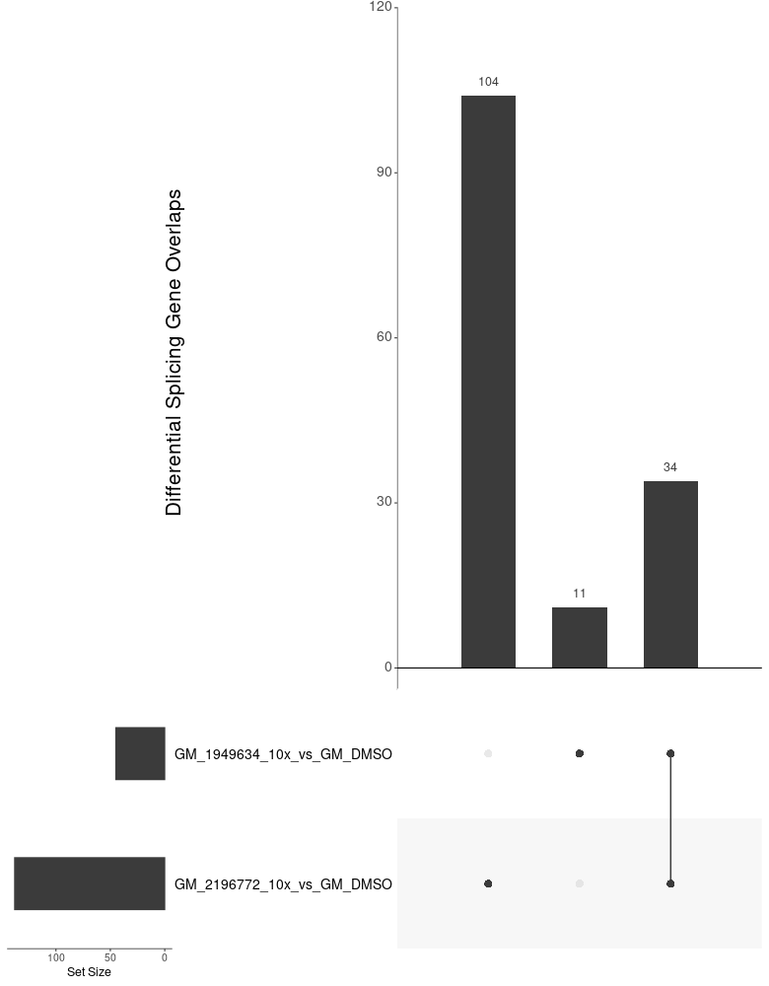
GM 3vs3 --10x
DSG BIO_2196772
DSG overlap (dPSI >= 0.25)
dPSI distribution ( >= 0.25 in one treatment)
dPSI distribution ( >= 0.1 in one treatment)

Slide 14
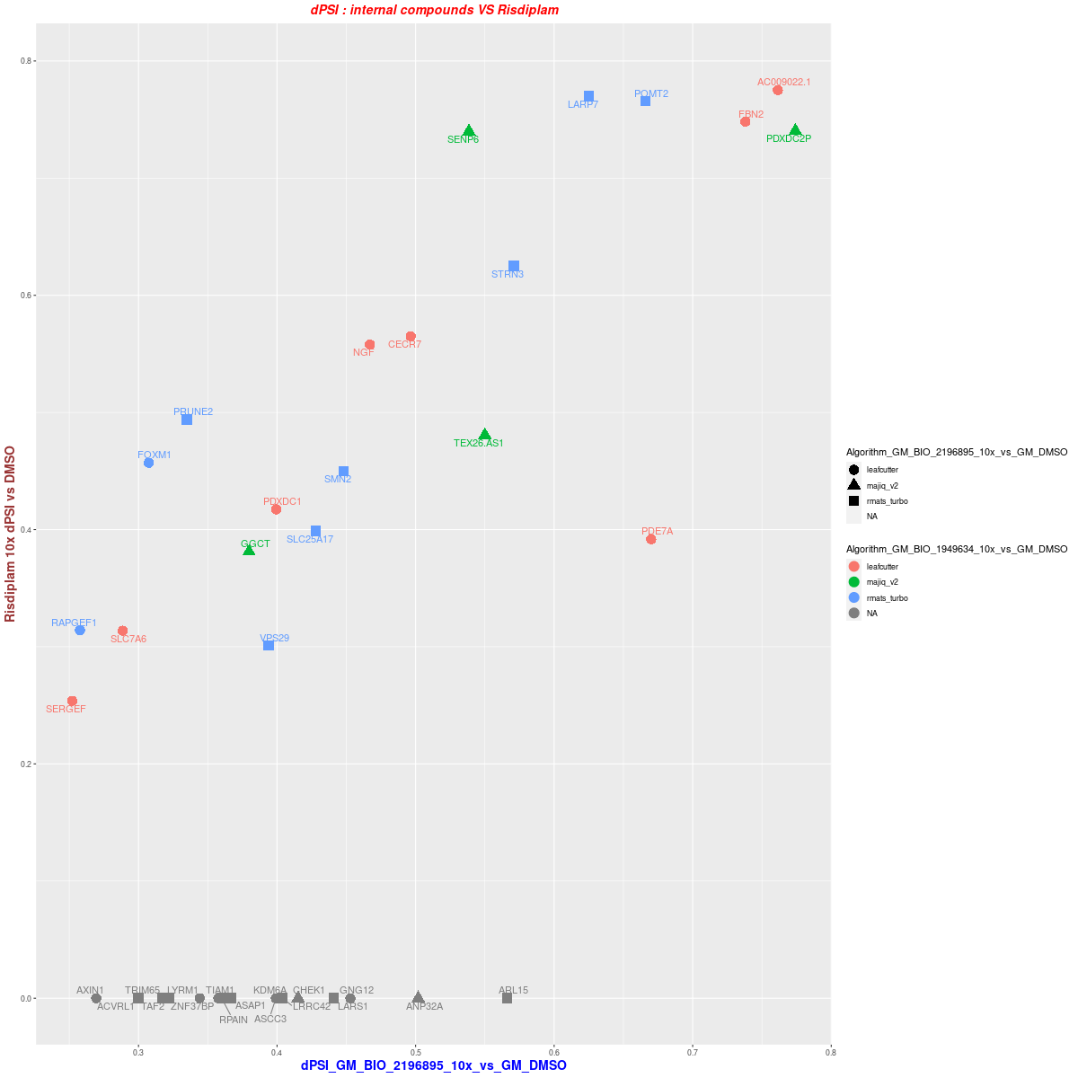
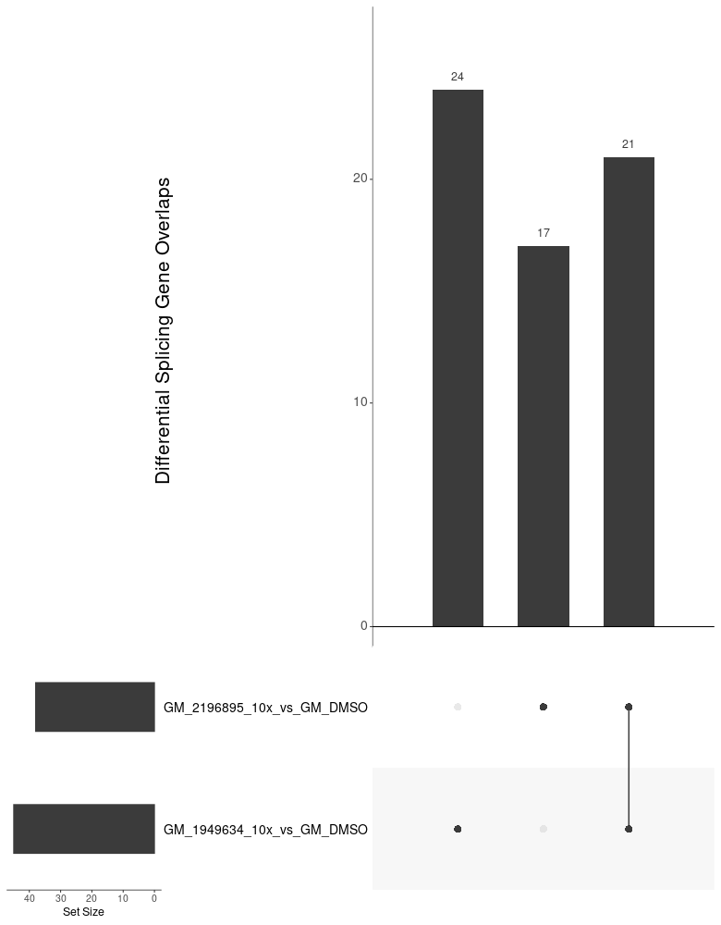
GM 3vs3 --10x
DSG BIO_2196895
DSG overlap (dPSI >= 0.25)
dPSI distribution ( >= 0.25 in one treatment)
dPSI distribution ( >= 0.1 in one treatment)

Slide 15
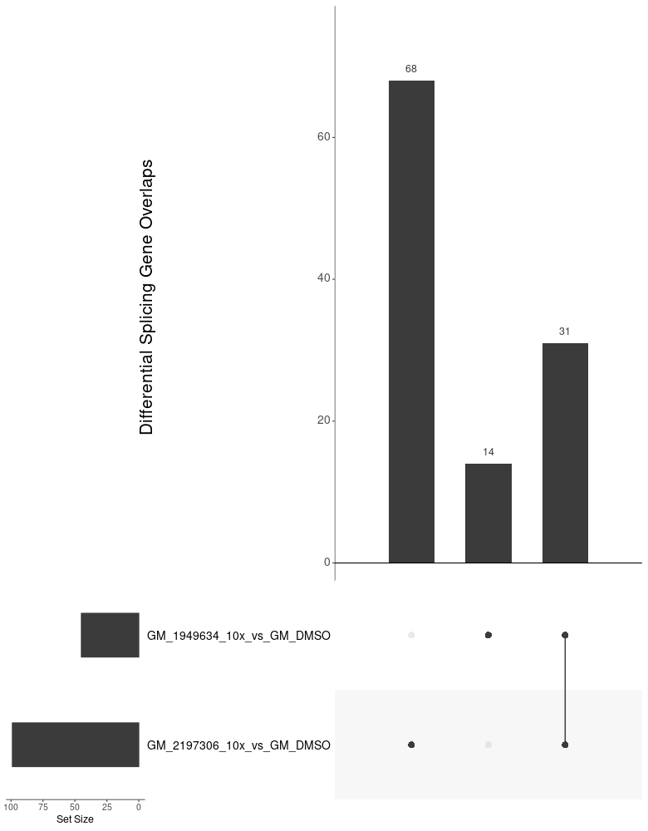
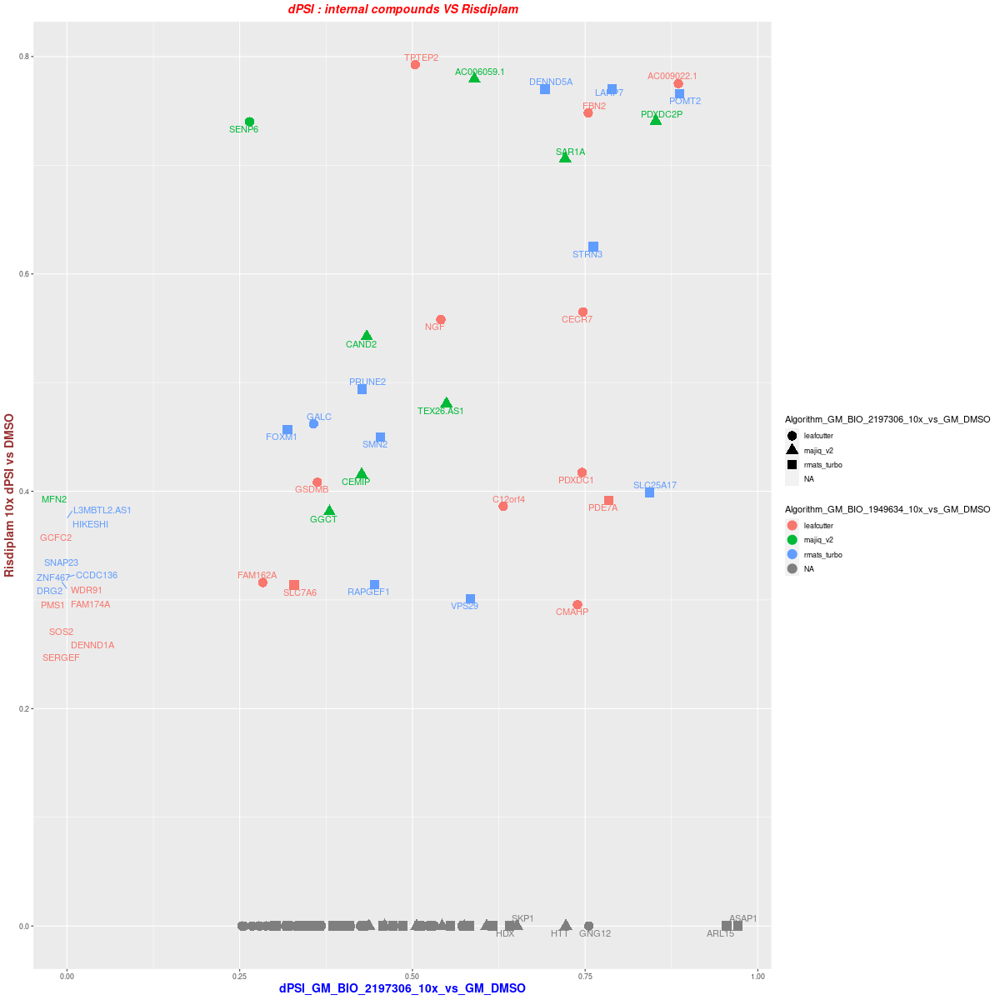
GM 3vs3 --10x
DSG BIO_2197306
dPSI distribution ( >= 0.1 in one treatment)

Slide 16
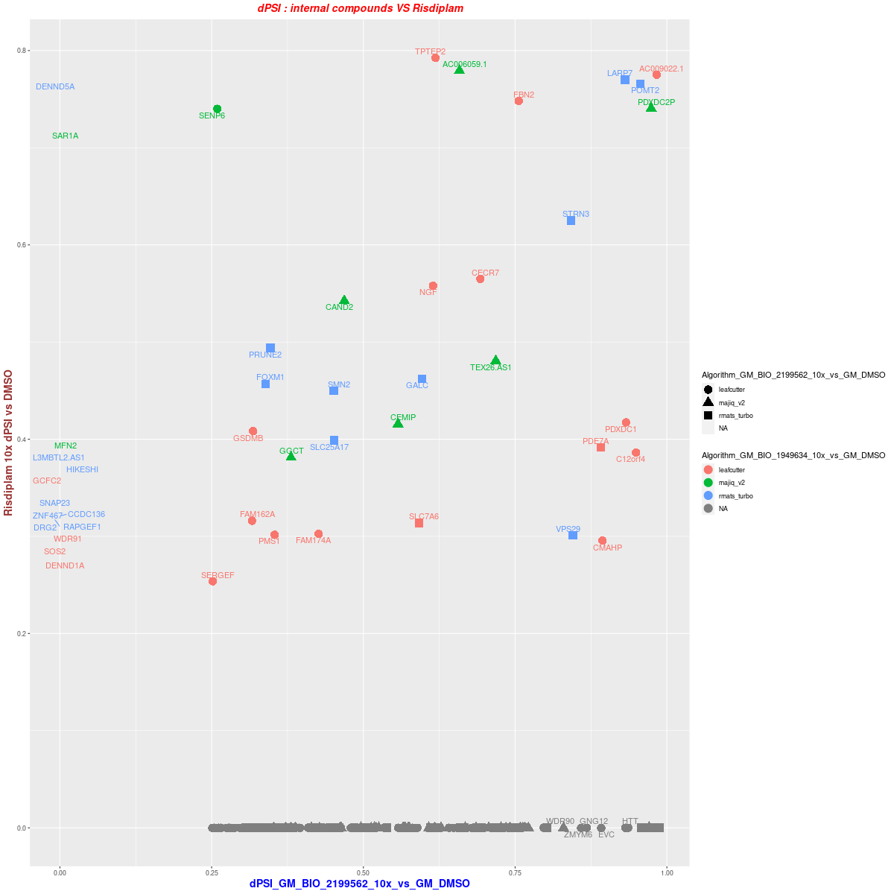
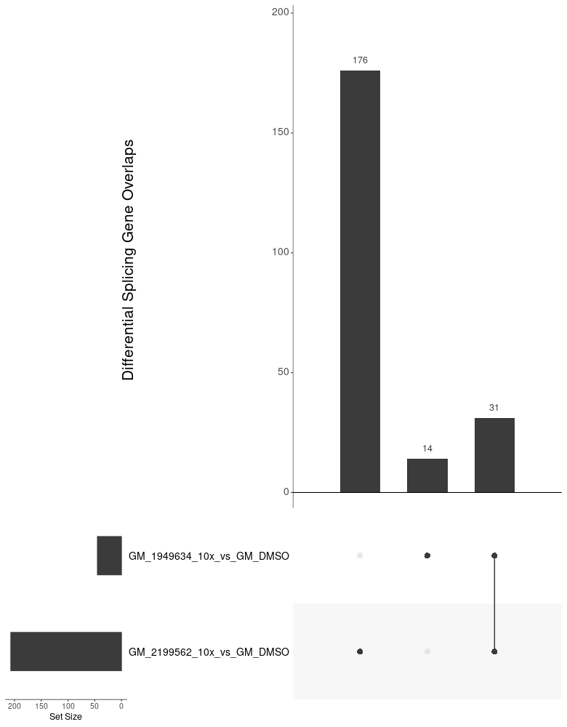
GM 3vs3 --10x
DSG BIO_2199562
DSG overlap (dPSI >= 0.25)
dPSI distribution ( >= 0.25 in one treatment)
dPSI distribution ( >= 0.1 in one treatment)

Slide 17
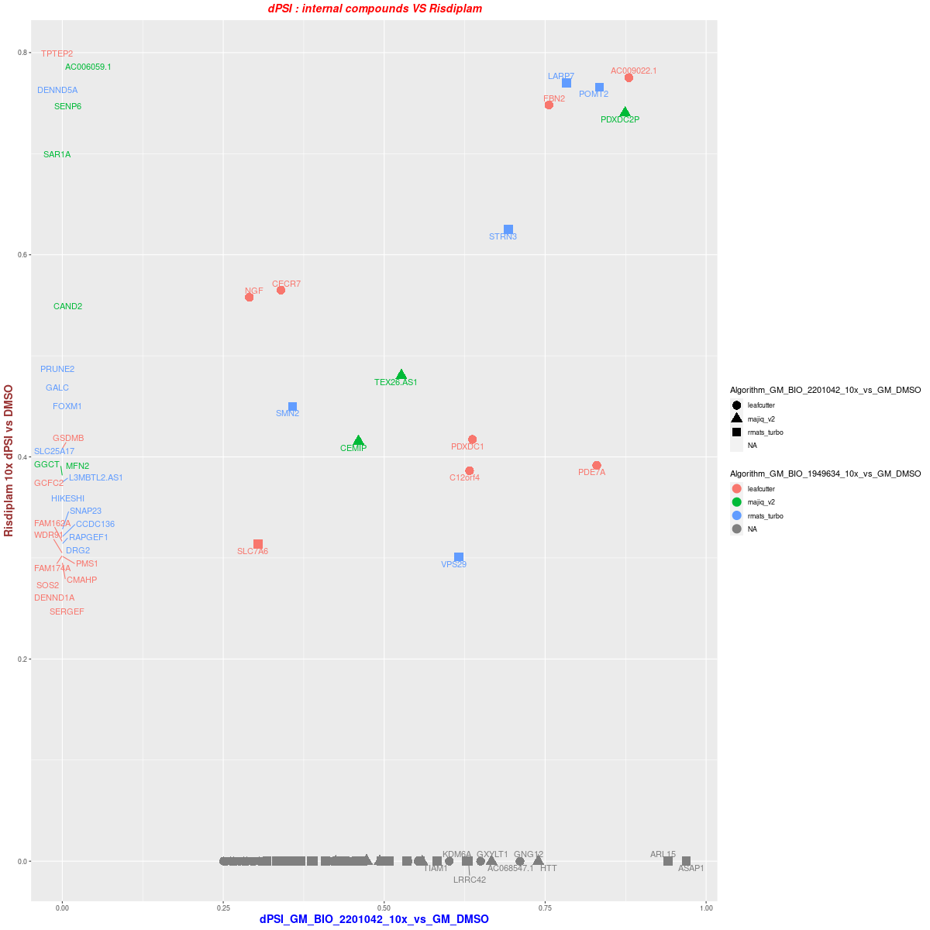
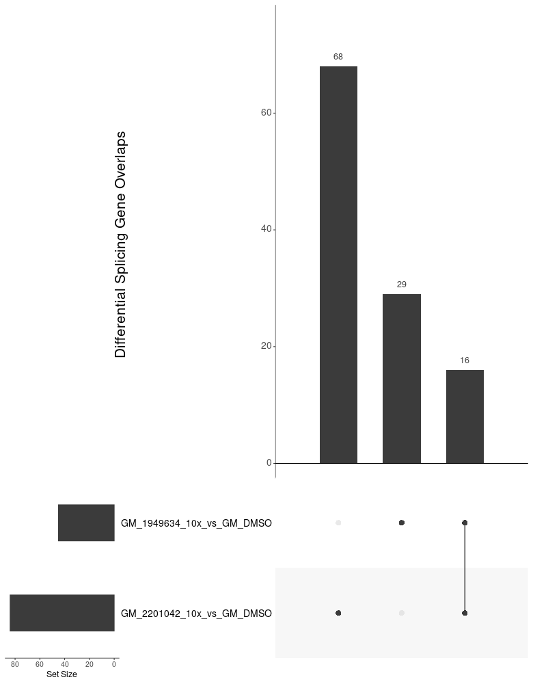
GM 3vs3 --10x
DSG BIO_2201042
DSG overlap (dPSI >= 0.25)
dPSI distribution ( >= 0.25 in one treatment)
dPSI distribution ( >= 0.1 in one treatment)

Slide 18
GM 3vs3 --10x
DSG BIO_2178782
DSG overlap (dPSI >= 0.25)
dPSI distribution ( >= 0.25 in one treatment)
dPSI distribution ( >= 0.1 in one treatment)

Slide 19
GM 3vs3 --10x
DSG BIO_2178782
DSG overlap (dPSI >= 0.25)
dPSI distribution ( >= 0.25 in one treatment)
dPSI distribution ( >= 0.1 in one treatment)

Slide 20
GM 3vs3 --10x
DEG
DSG overlap (dPSI >= 0.25)
dPSI distribution ( >= 0.25 in one treatment)
dPSI distribution ( >= 0.1 in one treatment)

Slide 21
GM 3vs3 --3x
DSG BIO_2178782

Slide 22
SH 3vs3 --10x

Slide 23
SH 3vs3 --3x

Slide 24
SH 4vs4 --10x

Slide 25
SH 4vs4 –3x

Slide 26
GM 3vs3 --3x

Slide 27
GM 4vs4 --10x

Slide 28
GM 4vs4 --10x

Slide 29
GM 4vs4 --3x

Slide 30
GM 4vs4 --3x

Slide 31
SH 3vs3 --10x

Slide 32
SH 3vs3 --3x

Slide 33
SH 4vs4 --10x

Slide 34
SH 4vs4 –3x

